Slide 1

Grassroots Neighbourhood Fund - A new Councillor led grant scheme
Councillor Information Session
3rd November 2025

Slide 2
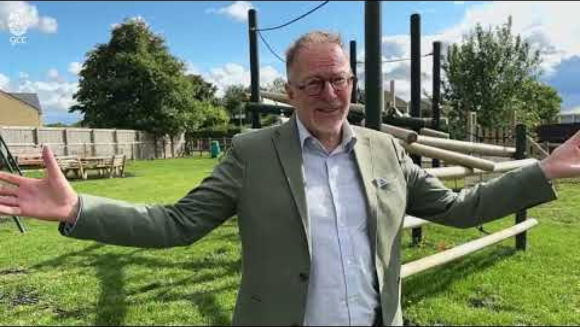
Introduction from Councillor Paul Hodgkinson

Slide 3

Aim of Grassroots Neighbourhood Fund
The scheme is focussed on providing grassroots support to local initiatives that seek to have a positive impact on health and wellbeing, including addressing health inequalities.

Slide 4
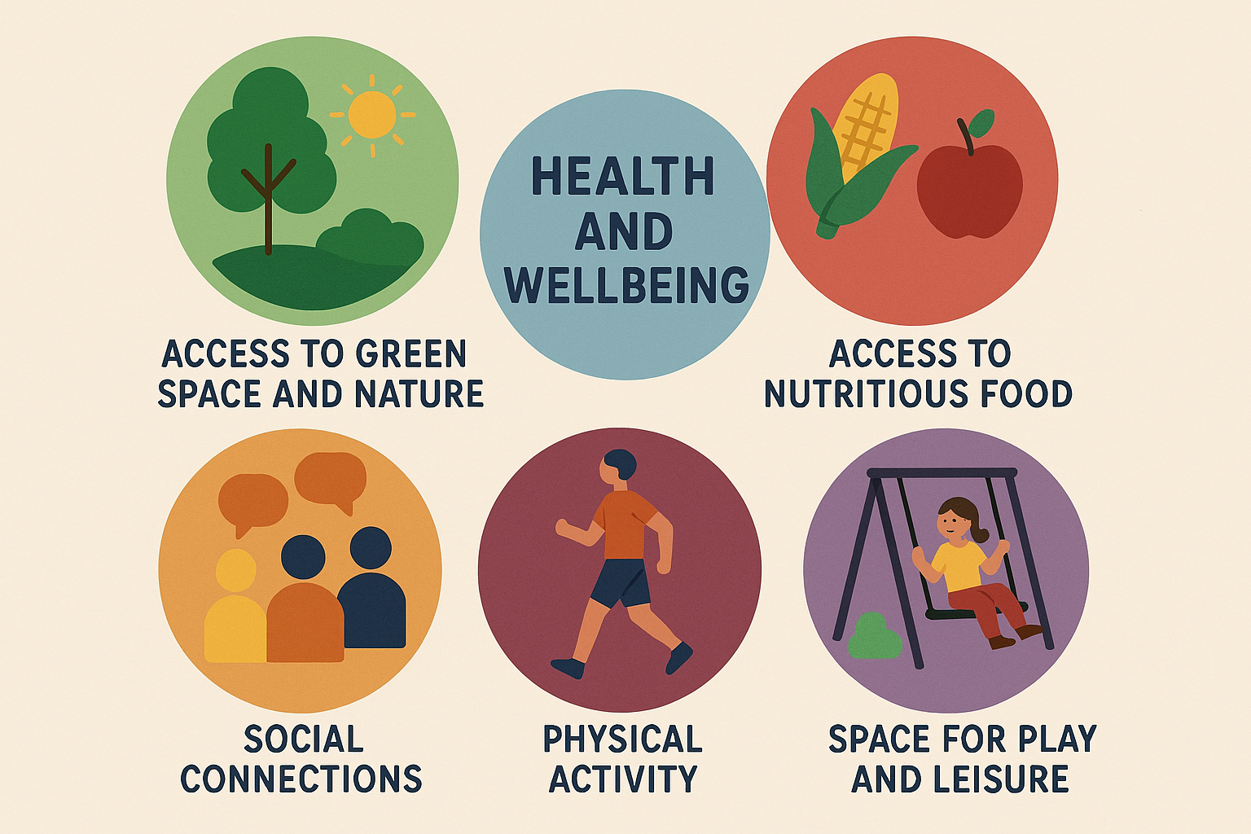
Things that impact Health and Wellbeing can include…
Some groups are more at risk of poor health and wellbeing than others…
Health and Wellbeing | Inform Gloucestershire
Notes:
Many factors in our lives can influence our health and wellbeing. These include:
The environments in which we live, work and play, whether we have access to green spaces (rural spaces such as parks, woodlands & allotments) and blue spaces (water-based spaces such as rivers, wetlands & ponds), and safe living environments.
Access to services.
Opportunities for good employment, quality education and skills development.
Our social connections and relationships, which can boost our wellbeing and reduce loneliness and social isolation.
Our health behaviours, such as whether we smoke, whether we have opportunities to be physically active, and access to affordable and nutritious food.
Our physical and mental health and resilience.
Making a positive difference to one or more of these factors can also help reduce health inequalities across our communities.
Much activity going on across our diverse county seeks to support this type of activity for local residents. Making a positive difference to one or more of these factors can have huge impact on health and health inequalities.

Slide 5
The Criteria
All projects must directly benefit physical or mental wellbeing.
The lower limit for applications is £250 and the upper limit is £5,000.
There is a total of £20,000 funding available per electoral division over the financial years 2025/26 & 2026/27.
Applications will be accepted between October 2025 and March 2027.
Projects must have plans to become self-sustainable.
‘For profit’ organisations are out of scope.
Projects can be supported by multiple councillors, but any one application cannot exceed £5,000.
Any additional funding required to enable the initiative to go ahead must be raised or secured before the grant will be released.
Applicants must ensure the proposed initiative is accessible and open to all.
Notes:
All projects must directly benefit physical or mental wellbeing.
Lower limit of £250 and upper of £5,000
£20,000 total funding available per electoral division: Funding available per electoral division will reduce as grants are awarded and once an electoral division’s funding is fully allocated there will be no additional money available in subsequent financial years.
October 25 and March 2027 - All funds allocated through the scheme will need to be paid to the applicant by 31st August 2027 (6 months after the end of the scheme application window). Any unallocated or unspent funds will be returned to Cabinet.
Projects must have plans to become self-sustainable.
The scheme is limited to ‘not for profit’ orgs, which includes:
Community or voluntary groups
Registered Charities
Community Interest Companies
Town and Parish Councils
Sports groups and associations
Schools and Academies
Patient led groups
Religious Groups where the application demonstrates that the initiative will bring wider community benefit, and the primary purpose of the activity is not religious
Organisations located outside of Gloucestershire where the application demonstrates that the funding will primarily benefit a Gloucestershire community.
‘For profit’ organisations are out of scope.
7. Projects can be supported by multiple councillors, but any one application cannot exceed £5,000.
8. If the project required additional funding (match funding provided by another organisation) in order to go ahead, this must be raised before the GNF grant will be paid.
9. The proposed initiative must give consideration to those with protected characteristics outlined in the Equality Act 2010; where appropriate initiatives can be specifically targeted to these groups.
10. Retrospective funding or expenses that have already been incurred will be considered if evidence is provided in the form of invoices and/or a bank statement and it is supported by the county councillor.
11. Any organisation applying must have a UK-based bank account, held in the name of the applying organisation, with at least two signatories.

Slide 6
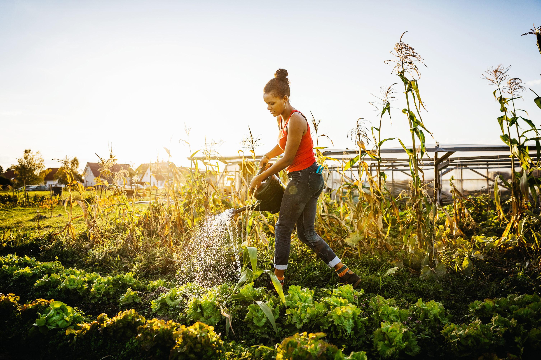
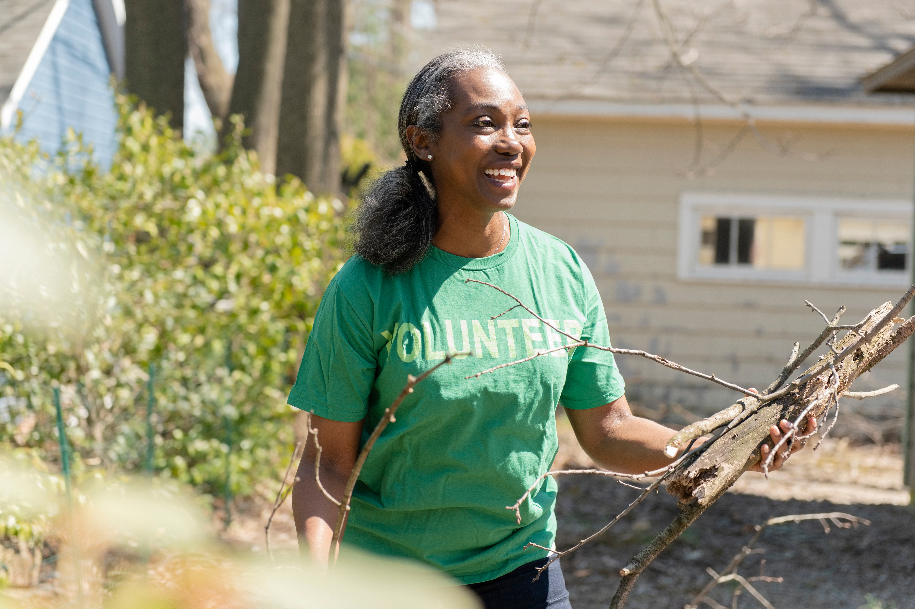
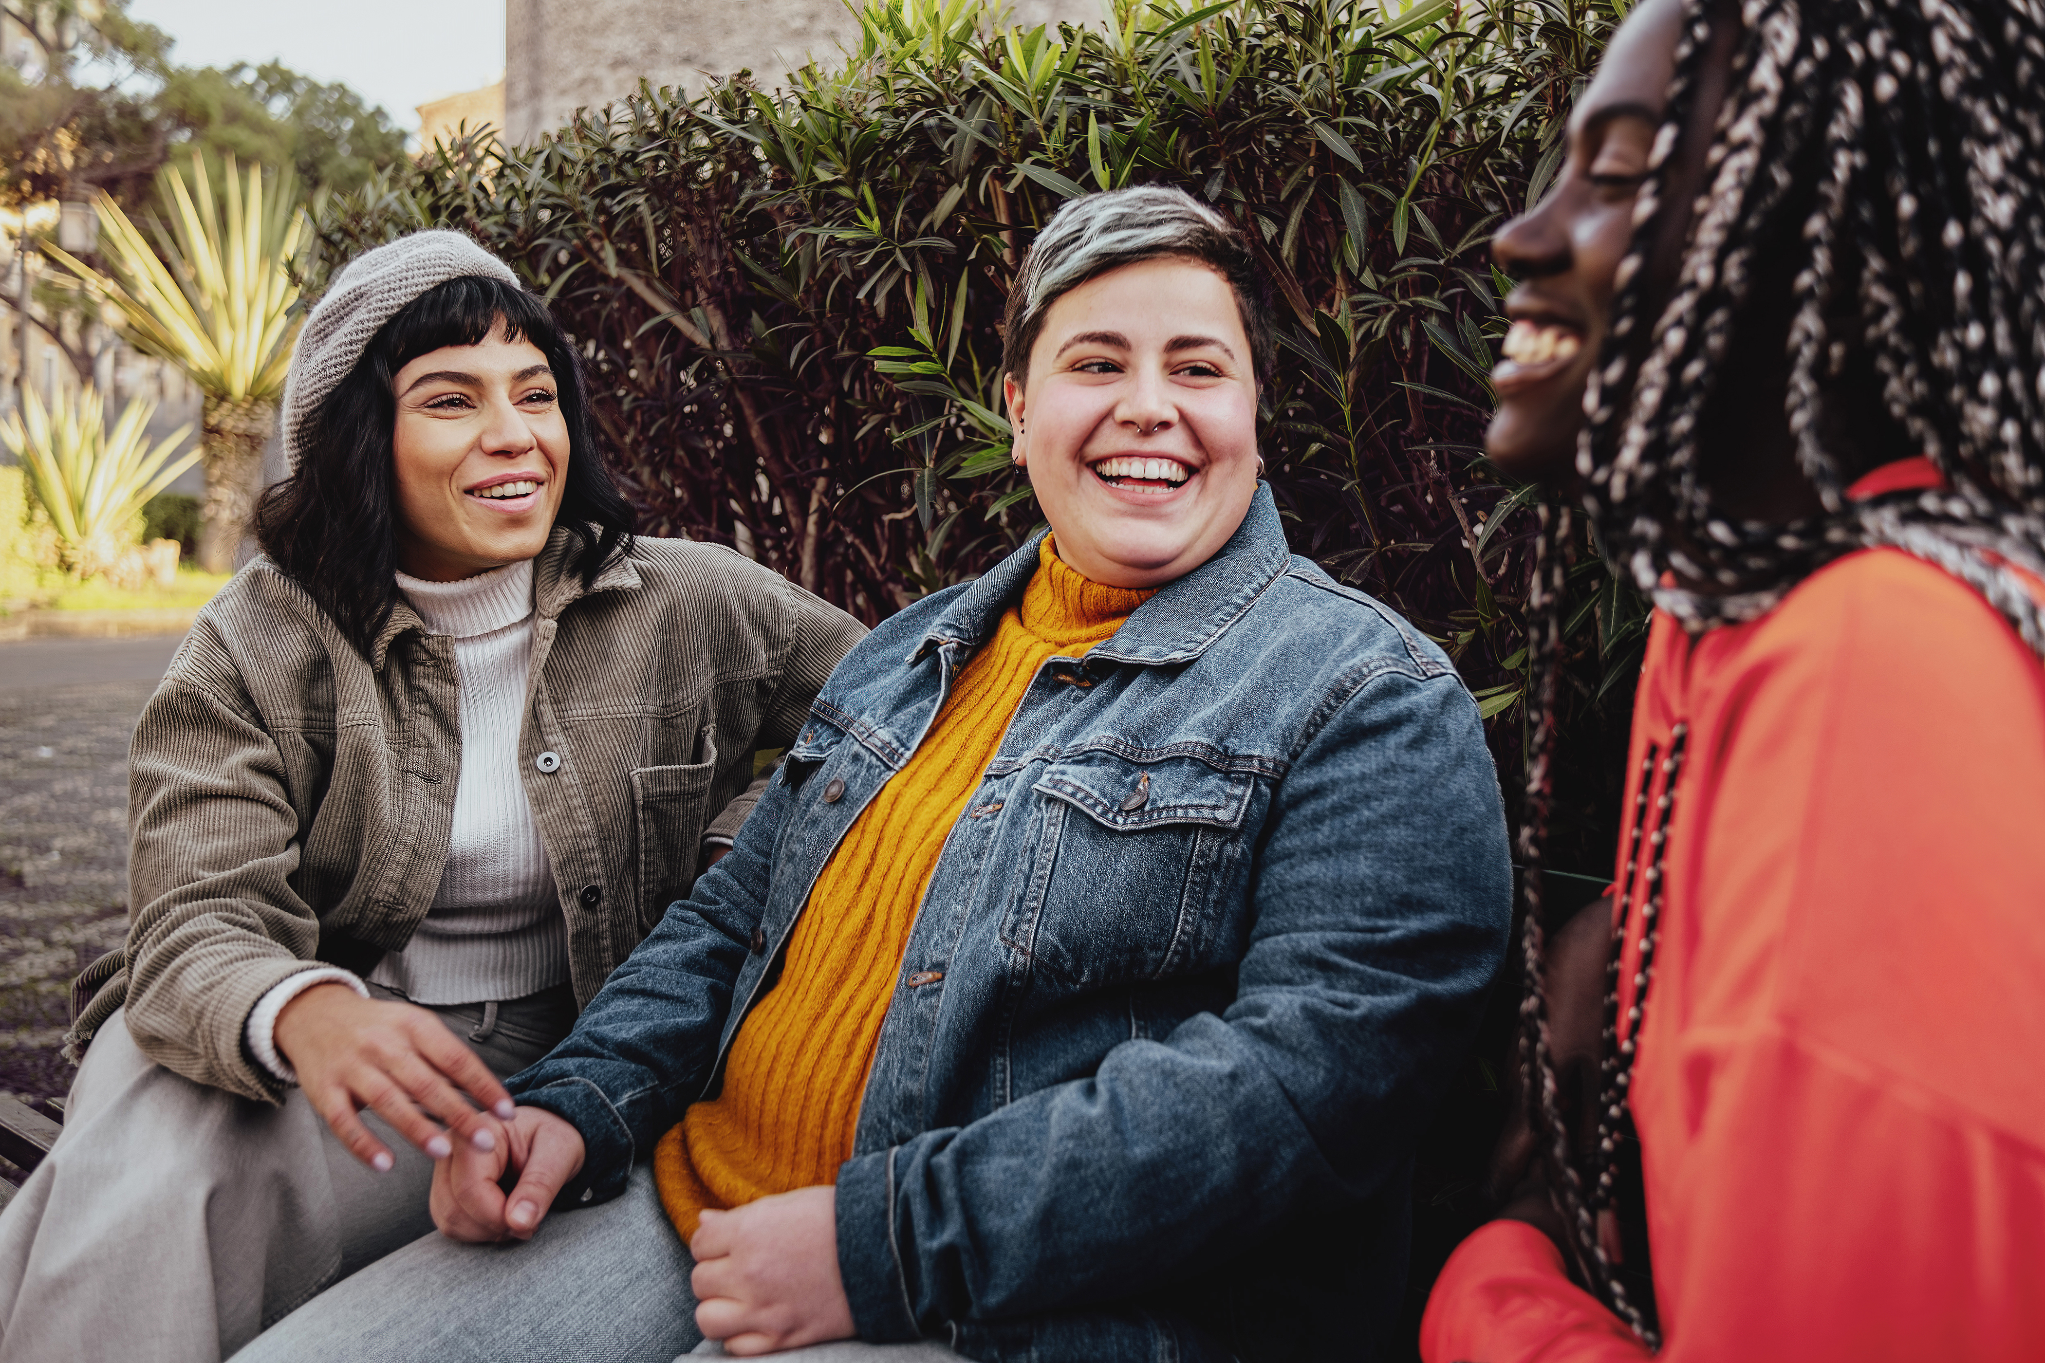

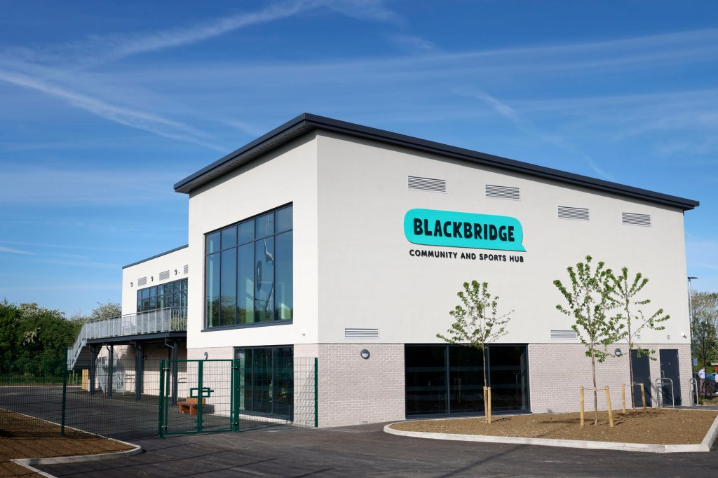


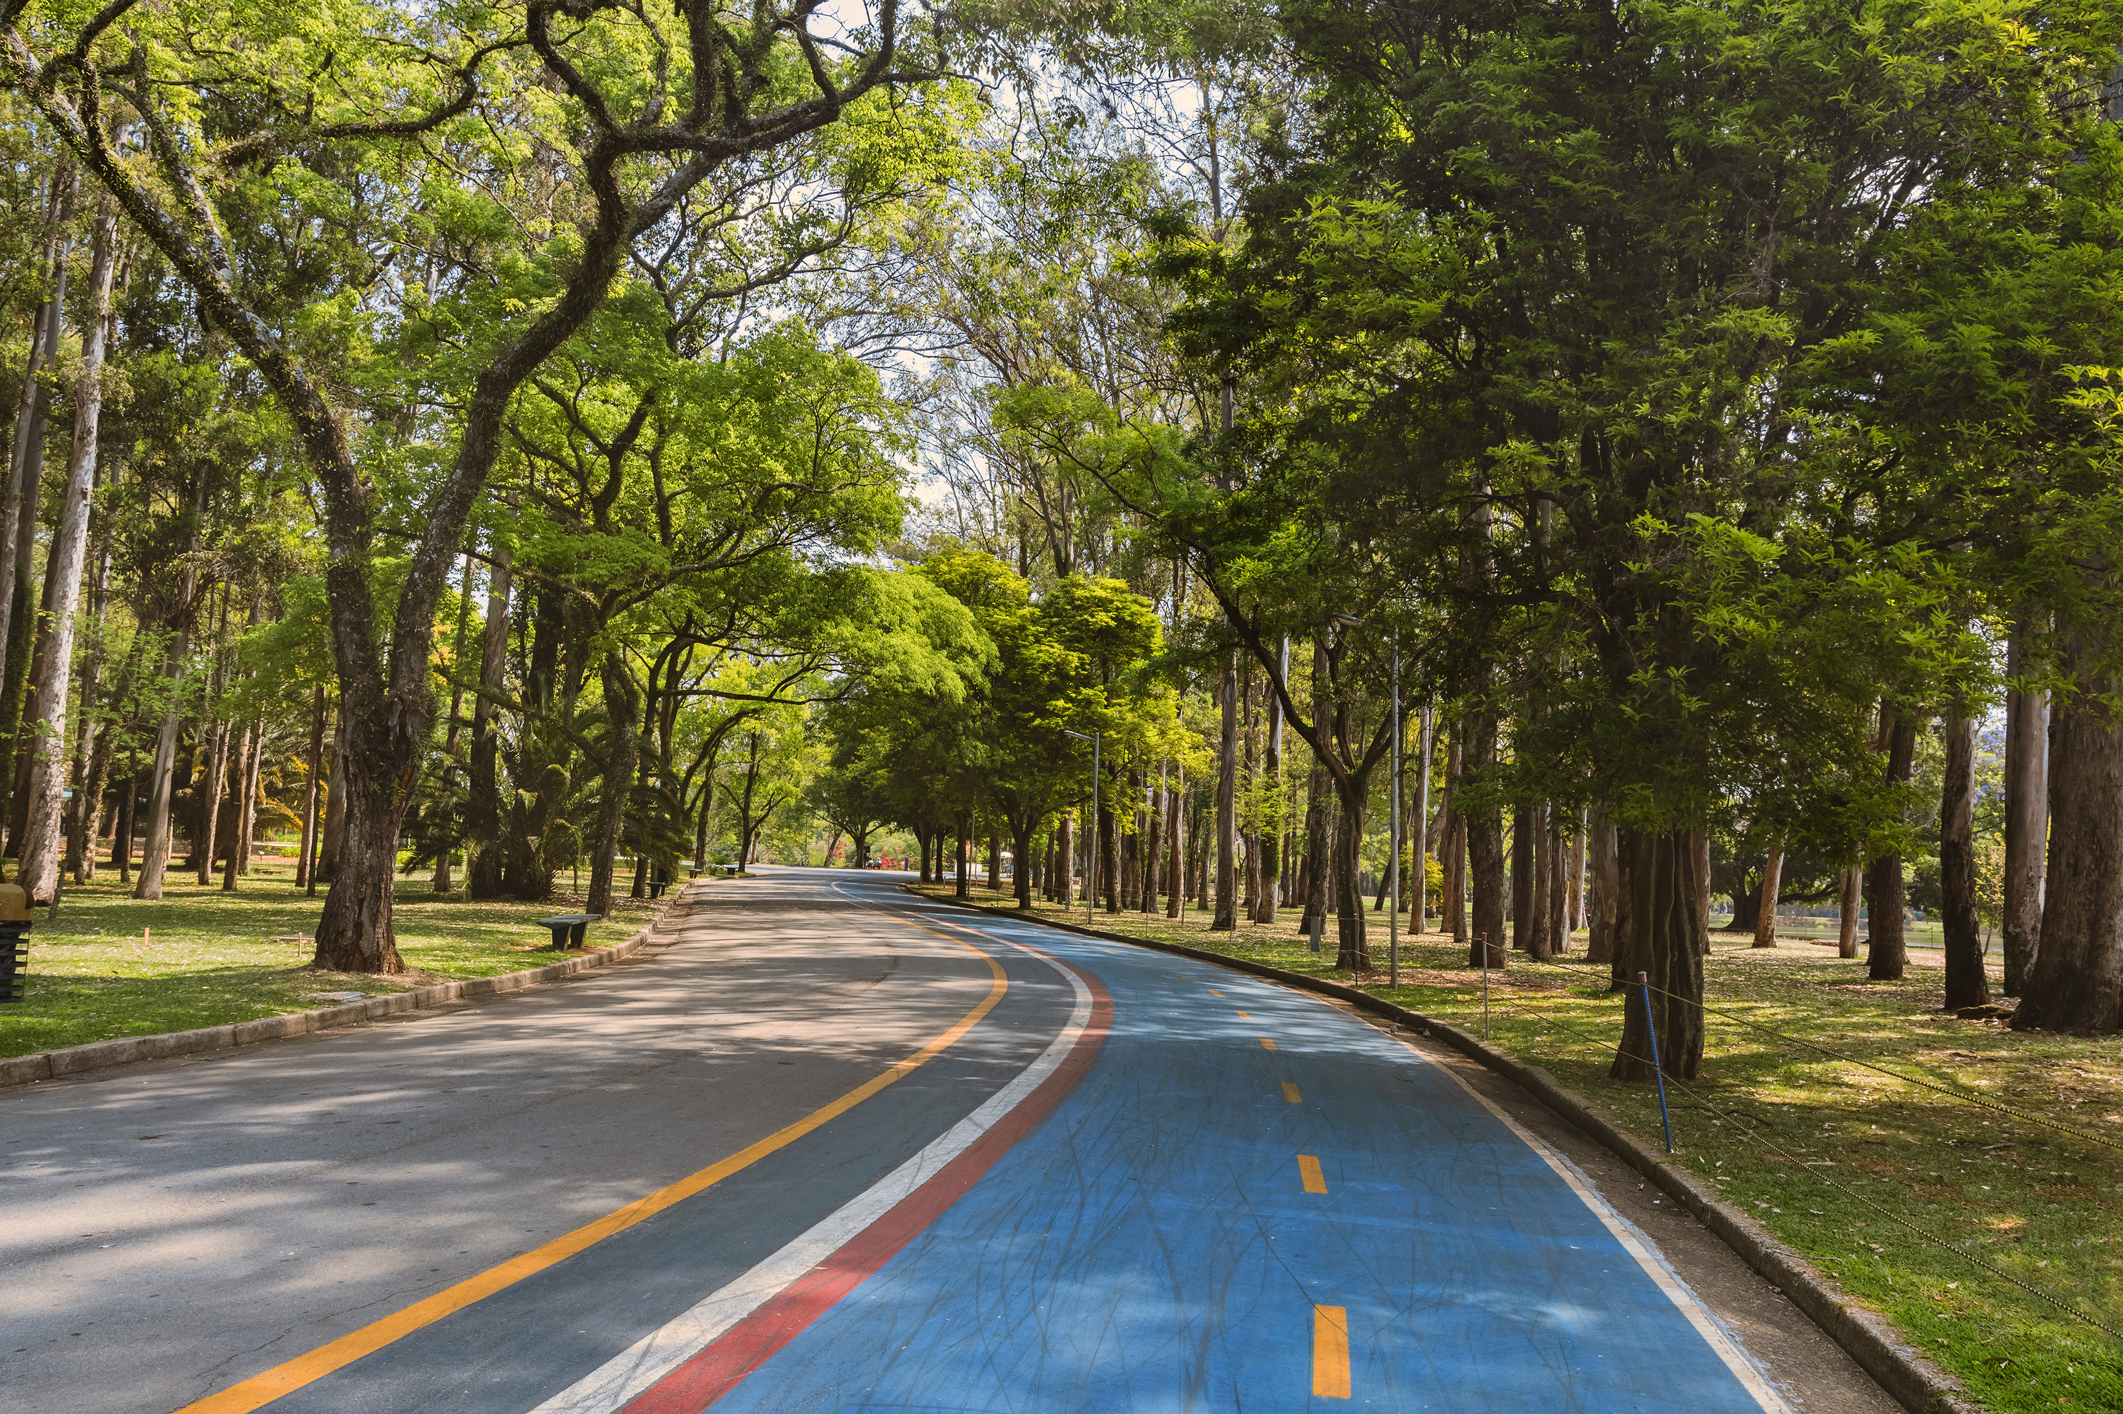
For Example
Friends of local parks
Community hub activities
Path improvements along a canal tow path
Lunch clubs
Creating cycle ways
Reduce digital inclusion
Food projects
One off events and celebrations
Village hall or sports club improvements
projects which encourage growing or increase biodiversity.
Notes:
Friends of local parks that encourage volunteering or create safer park environments.
Community hub activities that bring people together.
Path improvements along a canal tow path – encouraging access to nature.
Lunch clubs which support access to nutritious food and bring people together; helping reduce isolation.
Creating cycle ways – encouraging active travel.
Recruiting digital champions to reduce digital inclusion.
Food projects – encouraging access to heathy food.
One off events and celebrations – bringing communities together.
Supporting community buildings/assets for example village hall or sports club improvements
Nature initiatives such as projects which encourage growing or increase biodiversity.

Slide 7
The Application Process
7. GNF Team conduct due diligence checks
1. Potential applicant makes contact with County Councillor
4. Cllr completes endorsement form
Communication will occur throughout the process. The GNF Team will copy the Cllr into every email.
8. Final approval by Director of Public Health in consultation with LCM
2. If encouraged, applicant completes pre-application form
5. Full application form is sent to applicant
9. Grant paid
3. This is automatically sent to Cllr for endorsement
6. Applicant completes full application form
Notes:
For the first time, we’re introducing automation into the process, building on what we’ve learned from previous schemes to improve efficiency and responsiveness.
As some of you may already know, we’re using Microsoft Forms for both the pre-application and full application stages. To support this, we’re also using a tool called Power Automate, which helps streamline key parts of the process.
You can see the full process on the screen. It begins with the potential applicant contacting their county councillor to discuss their project as an idea. If the councillor encourages them to proceed, the applicant completes the pre-application form.
We’ve designed the pre-application form to be a proportionate way of seeking endorsement — helping applicants to avoid spending time on a full application if their project isn’t supported.
Once submitted, an email is automatically sent to the councillor, who then completes the endorsement form. This step is fully automated — removing the need for manual follow-up.
If the councillor endorses the project, the GNF team will receive an automated notification and will then manually send the full application form to the applicant to complete.
After the full application is submitted, the GNF team carries out due diligence checks. To make things even more efficient, responses from the full application are automatically pulled into an Excel document, which helps us manage and administer the scheme more effectively.
Final approval is then given by the Director of Public Health, in consultation with the lead cabinet member. The final step is the payment of the grant.
And just to reassure you — we’ll continue to communicate regularly. The GNF team will copy councillors into any relevant emails to ensure everyone stays informed throughout the process.
We're bringing in automation to help improve the process, but our team will still be here behind the scenes, ready to step in if anything doesn’t go quite as planned.

Slide 8



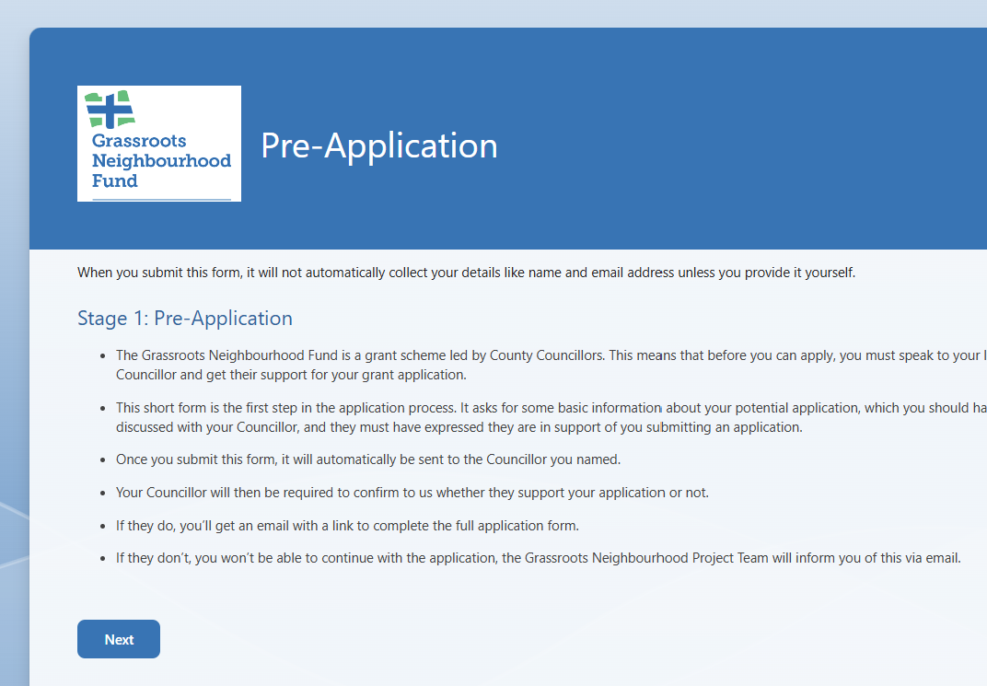
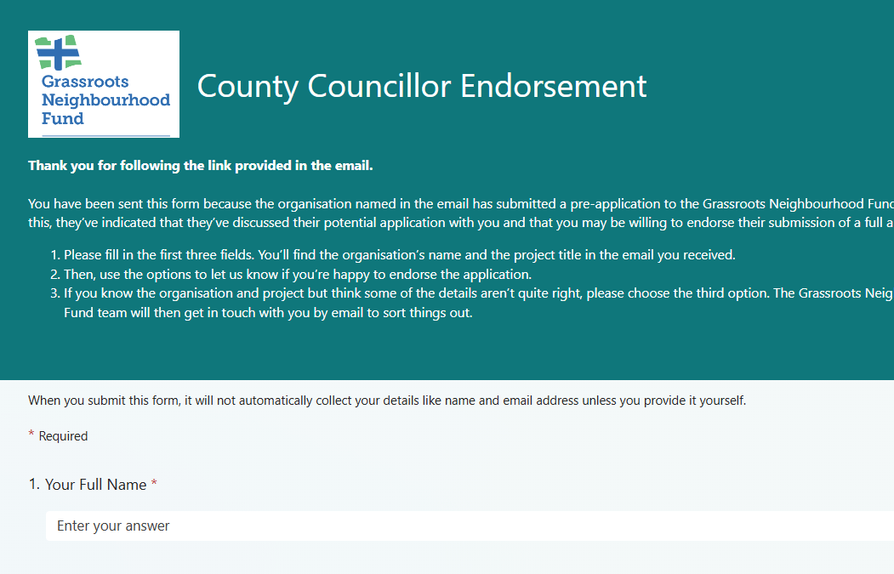
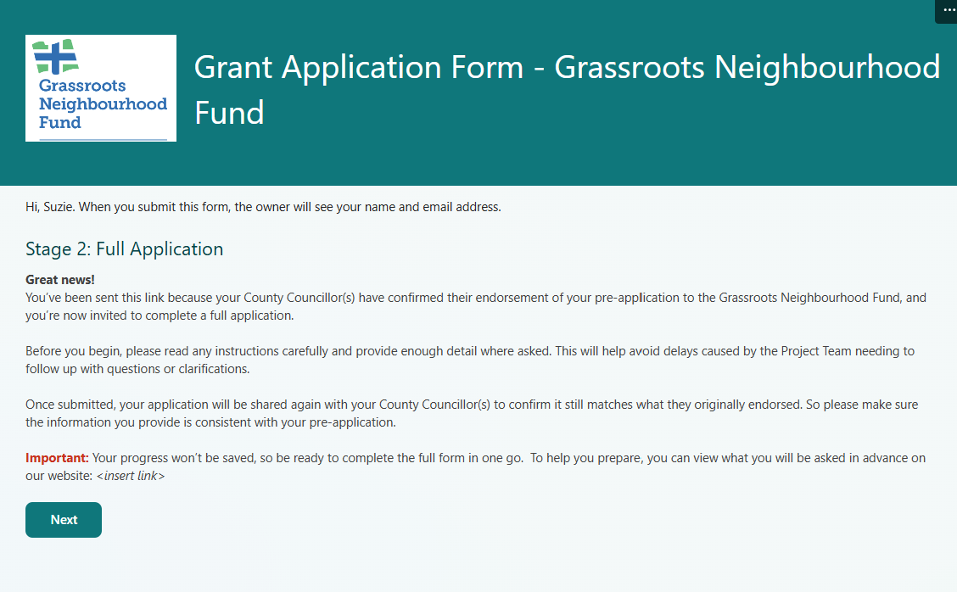
The Application Process – Power Automate
A
A
Notes:
On this diagram, the blue arrows represent manual steps, and the green arrows show the parts that are automated.
So, here's how it works:
(Click 1) It starts with the applicant having a conversation with their councillor to discuss their project. (Click 2). After that, the applicant manually submits a pre-application form — that's the first manual step. (Click 3).
Once the form is submitted, an email is automatically sent to the councillor (Click 4), who then completes the endorsement form. (Click 5)
(Click 6) When the councillor finishes the endorsement form, an automated email is sent to the GNF team (Click 7). This email confirms whether the councillor has endorsed the project, and it also gives them the option to endorse with amendments — for example, suggesting a different funding amount.
At this point, the GNF team steps in manually to send the full application form to those applicants whose projects have been endorsed (Click 8, Click 9).
So that is the process — a mix of manual and automated steps designed to streamline how we work and improve our responsiveness.

Slide 9
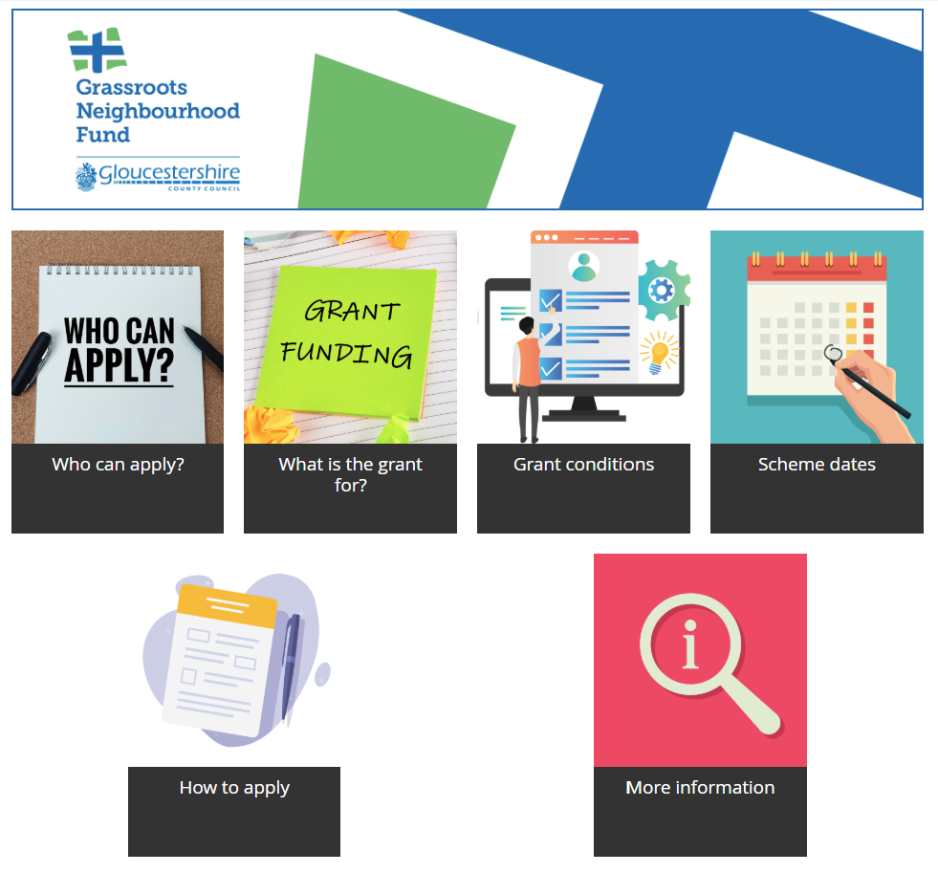
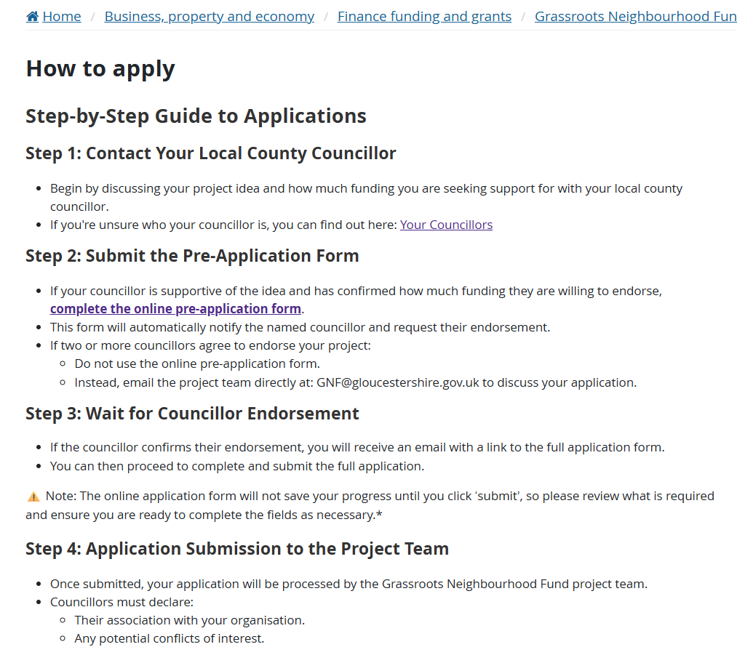
All Information is on the Website

Slide 10
Cllr FAQs
Q: Can an organisation apply multiple times and receive more than £5k in total?
A: Yes, they can. They would have to do this separately each time and each application would be risk assessed. Some additional due diligence checks would be required.
Q: Could someone fraudulently provide Cllr endorsement?
A: No, the GNF Team check the email address provided for Cllr endorsement and would take action accordingly. Cllrs will be copied into every email.
Q: Can an organisation apply to the Grassroots Neighbourhood Fund if they have already applied to Thriving Communities Grant?
A: Yes, they can.
Q: How will this scheme be evaluated?
A: All successful applicants will be issued with a survey link which will invite them to provide detail about how their initiative improved health and wellbeing for the intended recipients. Additionally, officers will undertake more thorough monitoring for some projects. A report will be produced at the end of the scheme summarising the impact.
Notes:
FAQ document to be updated with new questions as they come in and re-issued.
Evaluation – projects will differ significantly in their scope / intended outcomes and ability to collect monitoring data, so one size does not fit all. We will take a proportionate approach to gather outcome information, case studies

Slide 11
Questions and Feedback

