Slide 1
Cycling Forum
Local Cycling and Walking Infrastructure Plans
Sarah Williams
Principal Transport Planner

Slide 2
What is an LCWIP?
Local Cycling and Walking Infrastructure Plan
Department for Transport (DfT)
Cycle and Walking Investment Strategy (CWIS) April 2017
‘to make cycling and walking the natural choices for shorter journeys, or as part of a longer journey’
Local Cycling and Walking Infrastructure Plans (LCWIPs) Technical Guidance for Local Authorities
Long term approach to identifying cycling and walking improvements
High quality coherent, direct, safe, comfortable and attractive routes
Prioritised plan with a network to show where infrastructure should go
Network of corridors to submit for funding opportunities

Slide 3
Gloucestershire LCWIPs
www.gloucestershire.gov.uk/lcwip
Bishop's Cleeve LCWIP
Cam & Dursley LCWIP
Central Severn Vale LCWIP (Cheltenham and Gloucester)
Cirencester LCWIP
Countywide Cycling Infrastructure Plan
Newent LCWIP
Stroud LCWIP
Tewkesbury LCWIP V2. 2024

Slide 4
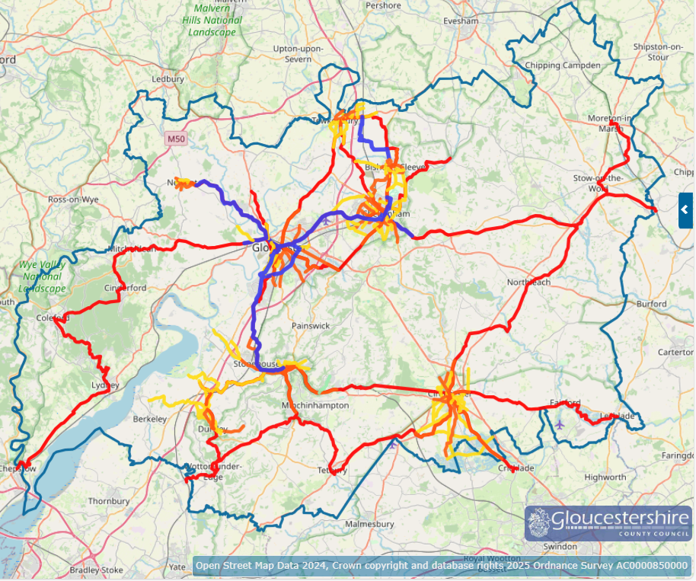

LCWIP networks
www.gloucestershire.gov.uk/lcwip

Slide 5
What does an LCWIP do?
An LCWIP sets the strategy to delivery infrastructure and allows us to bid for funding opportunities
Network Development
Local Transport Plan
Consultation
LCWIP
Scheme design
Prioritised corridors
Infrastructure delivery
Funding
Behaviour change
Active travel promotion

Slide 6
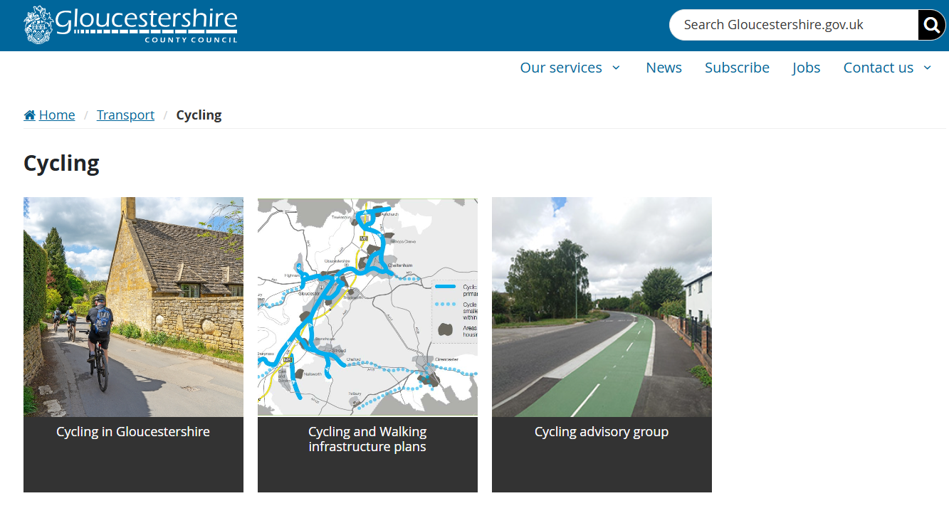
More information
www.gloucestershire.govuk/cycling
Sarah Williams
Transport Planning
01452 42 6793
ltp@gloucestershire.gov.uk

