Slide 1



School Readiness
Part 1. Achieving continence
Liz Wells Health Visitor
Aoife Price Health Visitor May 2021

Slide 2
Health Visiting Service
Website: www.ghc.nhs.uk
Add you Contact details here ……
eg Health Visitors Office,Stroud Community Hub at Stroud Maternity,
Field Road
Stroud
Glos
GL5 2JB
Telephone: 0300 421 896
Notes:
Health Visitors Deliver the Healthy Child programme ( PHE 2016 ) This is an offer to every family in the UK and is mostly taken up by families .
It comprises of 5 key contacts
Ante natal
NBV
6 week review
10-12 mth and 2 year Developmental Review using ASQ
Data will be collected using the evidence-based ASQ-3. ASQ-3
questionnaires are completed by parents and cover five domains of child development: communication, gross motor skills, fine motor skills, problem solving and personal-social development.

Slide 3
Health Visitors assess families health needs at every contact and will offer an enhanced service where a need is identified .
Universal; This means that the child will not have a named health visitor but can access our services at any time up to the age of 5 yrs or when they start school .
Targeted; This means that the child and family are receiving extra support from the Health Visiting Service
Specialist; This means that the child family are receiving multiagency support
Notes:
Most children in early years settings will not have a named Health Visitor but are open to our service until school entry .

Slide 4
Aims
To give Early Years Settings the knowledge to support the children and families with toilet training to become ‘School Ready ‘.
To motivate and encourage parent participation at the age in which the child should be encouraged to commence toilet training. 2 Years of age .
To feel confident in identifying common childhood barriers to toilet training , these may be physical , social or a child with additional needs .
Notes:
WHY :
Learning to use the toilet is one of the most important skills a child can learn. It has a large impact on the child, family and everyone caring for them.
The significant advantages for children and young people in being toilet trained are:
An increase in independence
An increase in confidence
An increase in self esteem
More opportunities for being with their friends and joining in social activities
A reduction in the stress of continued changing and cleaning
A reduction in only being able to access venues that have changing facilities – especially in older children.
A reduction in isolation
A reduction in the possibility of the child being bullied
A reduction in the ongoing cost of products such as nappies/pads
For education and care staff the advantages of working with a child/young person who is clean and dry are huge. Less time will be spent in the bathroom, giving more time for the child to learn new skills and be with their peers.

Slide 5
Key Messages
Early assessment and support from the second year of life to facilitate the development of the skills necessary for toilet training .
Children where it is known or anticipated there may be difficulties with toilet training e.g. learning disabilities or autism, should have the opportunity for early intervention (at around 2 years of age) to facilitate the development of the necessary toileting skills (Guidance for the provision of continence products to children and young people 2016)
It could be considered as discriminatory if children with disabilities are not supported to attain continence in the same way as children who do not have disabilities
( Guidance for the provision of continence containment products to children and young people A consensus document 2021)
Notes:
All children and young people must be supported with a toilet training programme for at least six months, prior to containment products being provided to them, unless it is clear that this is inappropriate as defined a specialist.
Barriers put forward to delay toilet training .
Parents carers don’t know where to begin ?
Toddler doesn’t understand what is required ?
Toddler can’t talk so can’t ask?
Toddlers behaviour becomes unmanageable ?
Busy household – “will wait until things settle down”?
Entitlement to ‘free nappies’ owing to disability ?
Toddler unable to sit – physical disability ?

Slide 6
Usual development of bladder and bowel control
Control of bowel when asleep at around 1 yr
Control of bowel when awake at around 2 yrs
Control of bladder when awake at around 2- 3 yrs
Usual age for night-time dryness is 4yrs and up
If a child is having bowels open when asleep over the age of 1 year this would be indicative of constipation and stool withholding.
Assess for Constipation.( this will be addressed later )

Slide 7
Signs that I’m ready to start to toilet training
Is your child Aware of wees and poos?
Do they have a regular working bowel with no signs of constipation?
Do they eat a good balanced diet and drink plenty of fluids to keep their bowels and bladder working well?
Have you noticed that they are able to hold their bladder for several hours, with dry nappies or pants
Can your child manage their own clothes and dressing when they use the toilet? If not you can begin to practice this
Can your child manage to wipe themselves? This may take time and lots of practice so its good to start encouraging self care skills like Washing their hands and flushing the toilet.

Slide 8
Common Problems to be resolved before Toilet Training
Constipation and Soiling.
Encopresis. Passing a poo anywhere but the toilet !
Parental and professional misconceptions ‘ child disabled ‘’ child
unable to talk ?’
Physical barriers
Engaging and supporting parents .
Notes:
We will address each of these in order .

Slide 9
Keep the fluids up…to keep the bladder full
Water is best
Minimum 6- 8 glasses a day
https://www.nhs.uk/news/food-and-diet/six-to-eight-glasses-of-water-still-best/
Keep water available throughout the day
Avoid fluids with caffeine in such as tea, coffee, fizzy drinks and limit milk to 2-3 small cups a day.
Eat 5 portion of fruit and vegetables
https://www.nhs.uk/change4life/food-facts/five-a-day
Watery fibre may be good for some children such as cucumber, watermelon, melon

Slide 10
What is soiling ?
Soiling is when a child regularly poos their pants. If they're already potty-trained, the soiling is usually because they are badly constipated. Treatment from a GP will be indicated .
A child who soils shouldn’t be seen as lazy; they have no control over it, can’t feel it and often don’t smell it either.
Refer to links below for advice to explaining soiling and treatment
Refer to Health Visitors for further assessment and advice .
https://www.eric.org.uk/signs-of-constipation
https://www.youtube.com/watch?v=9WqxJqLmKao
Strongly advise to watch you tube video for further explanation . This link can be given to Parents and carers
Notes:
Severe constipation can cause faecal impaction – when a very big poo or build-up of poo gets stuck in the rectum, the lowest part of the bowel.
Faecal impaction causes the rectum to stretch and the sensation of needing the toilet is reduced. When stretched, the rectum becomes floppy, making it more difficult to pass a large poo.
Impaction can lead to faecal soiling or overflow, where small bits of poo break off into the child’s pants or soft, sometimes runny poo leaks around the large blocked mass in the rectum. Soiling is often mistaken by parents for diarrhoea.

Slide 11
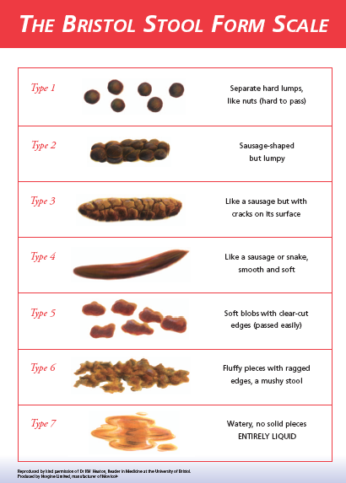
Bowels: what is normal?
Always refer to Bristol Stool Scale to identify stool type
Check how often stools are passed per day/week . Use Bowel chart on N drive to record for 2 weeks and complete on S1 continence template
Consider Size; large, med, small
Does child experience pain or distress on passing stool .
Record where Stool is passed ;toilet, nappy, pants
Pants: clean or soiled , if soiled how often ?
Note any current Medication
Normal is: type 4
3 times a day to 4 times a week

Slide 12
Encopresis
The term for the passage of normal stool in an inappropriate place , usually in their pants or for example a child who chooses to do their poo behind the sofa, or in the corner of their bedroom.
For some children it may be associated with sensory concern or Intreroception . ( eighth sense )
Interoception: The New Topic in Autism - YouTube
www.eric.org.uk
Understanding-Toilet-Refusal-The-Child-That-Will-Only-Poo-in-a-Nappy-1.pdf
Sensory needs and toileting | ERIC
Notes:
Look up Interoception: The New Topic in Autism - YouTube

Slide 13
Toilet Training and Healthy Bladder and Bowel information
Support with toilet training, information and resources are available from ERIC to help your child have a healthy bladder and bowel to achieve continence.
https://www.eric.org.uk/
https://www.bbuk.org.uk/
Additionally please contact your health visiting team for further support or drop in to your local baby hub.

Slide 14
Nappies; use in toilet training
Modern disposable nappies contain ‘super absorbency beads’ which lock away wetness, child is comfortable, no leakage, therefore has no discomfort/consequence for wetting
No consequences for wetting means the child is then unable to accept responsibility for actions
Feeling wet is essential to the learning
If a child never feels wet, the learning and understanding of desired toilet training skills & behaviours can be delayed
Notes:
Expand with tips regarding pants under nappy
Kitchen roll to check for wetting or blue line

Slide 15
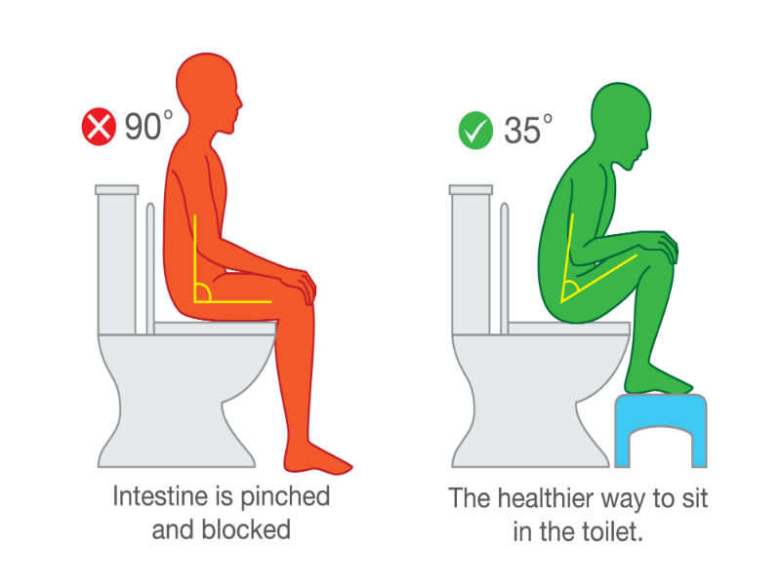
Correct way to sit on the toilet
Children needs to feel secure when they are sat on the toilet.
Their feet need to be secure on the ground or step.
Their knees need to be higher than hips or semi-squat.
Leaning forward with their elbows resting on their knees.
Things to watch out for:
If a child is leaning back, child could be stool withholding.
Notes:
Tips on blowing bubbles
What motivates the child ?
Rewards for complying with toilet sits rather than results

Slide 16
Engaging and supporting parents
Negotiate and involve parents carers in toileting goals .
My Plan
Signposting to Health Visitor for continence assessment.
Consider Toileting Skills assessment in My Plan to monitor progress

Slide 17
Resources
Signpost to www.eric.org.uk
https://www.bbuk.org.uk/
https://www.cerebra.org.uk/help-and-information/guides-for-parents/toilet-training/
https://www.bbuk.org.uk/wp-content/uploads/2018/04/Promoting-Healthy-Bowels.pdf
https://www.eric.org.uk/managing-continence-issues-at-nursery-school-and-college
Change for life https://www.nhs.uk/change4life
Children Continence team/champions email of Continence service
Radar Key scheme foe SEND https://www.disabilityrightsuk.org/shop/official-and-only-genuine-radar-key
How macrogols work https://www.youtube.com/watch?v=9WqxJqLmKao
Poo goes to Pooland app https://play.google.com/store/apps/details?id=uk.nhs.ntw.poogoestopooland&hl=en_GB
Constipation & use of Macrogol https://m.youtube.com/watch?v=9WqxJqLmKao&t=251s

Slide 18


