Slide 1


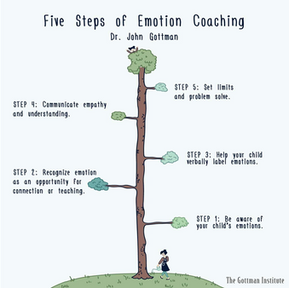



What You Can Do as a Parent
Where to Get Help
Gloucestershire Specialist Teaching & Educational Psychology Service
Listen openly – Validate your child’s emotions
Gloucestershire Educational Psychology Service
Helping Your Child with School Attendance
Support emotional literacy – Help them name their feelings
This leaflet is a summary and there is more detailed guidance on ‘Barriers to Attendance’ on EPS website
Take small steps – work with your child to consider gradual changes that feel possible and important.
Work with the school – Consistent communication helps form a shared plan and share updates.
https://www.gloucestershire.gov.uk/education-and-learning/educational-psychology-service-eps/
'Understanding factors that can contribute to barriers to attending school'
Local Support Services
Educational Psychology Service (EPS) & Advisory Teaching Service (ATS)
CAMHS (Child & Adolescent Mental Health Services)
Teens in Crisis (TIC+) for young people and parent advice & support
Young Minds Matter (YMM)
Using approaches like emotion coaching and tools like scaling, drawing, and solution-focused conversations
Brief Parent guide
"What's one small thing that, if you did it, would make going to school a little bit easier or more enjoyable for you?"

Slide 2



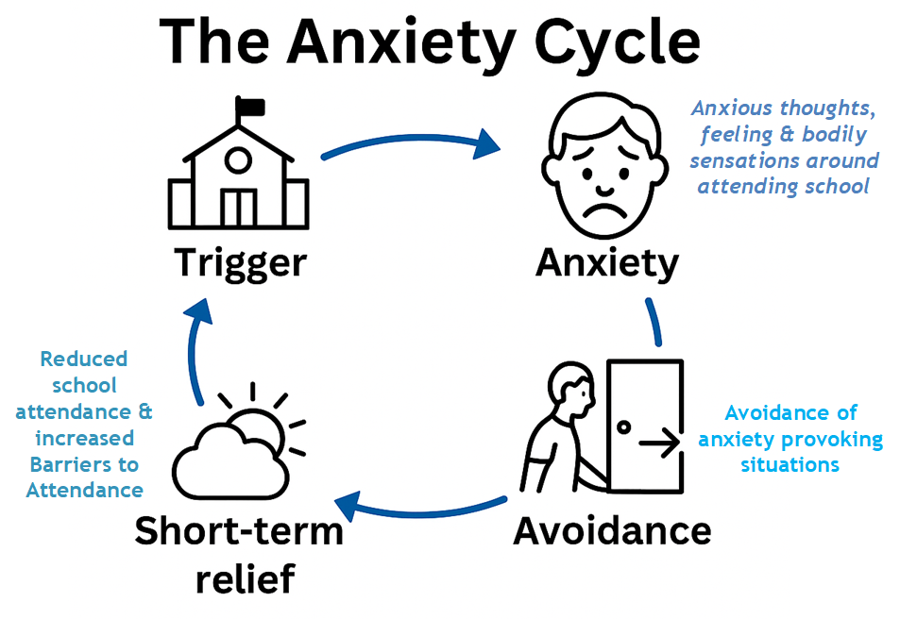
The Anxiety Cycle
Push and Pull Factors
This model helps explain what may affect a child’s attendance at school:
What are ‘Barriers to attendance’?
Anxiety affects the body, mind, and behaviour. It can become a cycle. An example may be:
Thoughts: "This work is too hard."
Feelings: Worry, fear
Sensations: Heart racing, tears
Behaviours: Avoidance or refusal to attend
There are unique and sometimes complex reasons (experiences and emotional responses) that can become barriers to some young people attending school. They may experience emotions such as fear, anxiety and overwhelm, despite wanting to attend school.
These children often want to go to school—but feel overwhelmed by anxiety or fear.
Push Factors – Factors which encourage school attendance
Positive peer relationships
Enjoyment of subjects
Feeling safe and supported
Barriers can be due to a range of factors, such as :
Emotional distress
Social challenges
Past trauma
Learning needs or school pressures
Pull Factors – Encourage school non-attendance
Feeling calmer at home
Reduced social or sensory demands
Anxiety or fear related to school environment
Based on training by Dr J Holder (2024)
Every time school is avoided, the anxiety temporarily goes down—but the cycle becomes stronger and harder to break.
Each child or young person’s experience will be different, and there may be multiple factors impacting them.
Anxiety may not be the only reason for difficulties for school attendance difficulties, however it often has a role.
Barriers to attendance can occur when “stress exceeds support, when risks are greater than resilience and when ‘pull’ factors that promote school non-attendance overcome the ‘push’ factors that encourage attendance”
(Thambirajah et al, 2008: pg. 33).
Attendance is not fixed and can vary according to the child’s emotional wellbeing and resilience and/or support offered by the school and family.

