Slide 1
Young people in Gloucestershire
Data and Analysis Team

Slide 2

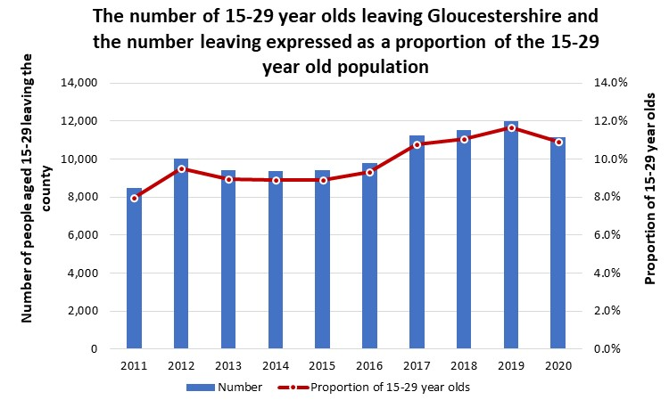
Young people
An average of 10,247
15-29 year olds leave the county each year
This equates to 9.8%
of the age group
But an average of 9,997
15-29 year olds move to the county each year
On average
250 more 15-29 year olds leave the county than move to it
Notes:
Overall, between 2011-2020, an average of 10,247 15-29 year olds left the county each year
This equates to around 9.8% of the population aged 15-29
2019 saw the greatest loss of its 15-29 population with 11.7% leaving
But in addition, an average of 9,997 15-29 year olds moved into the county each year
2019 saw the greatest gain of 15-29 years olds in terms of the proportion of its 15-29 year olds at 11.5%
On average 250 more 15-29 year olds left the county then moved into it between 2011-2020

Slide 3
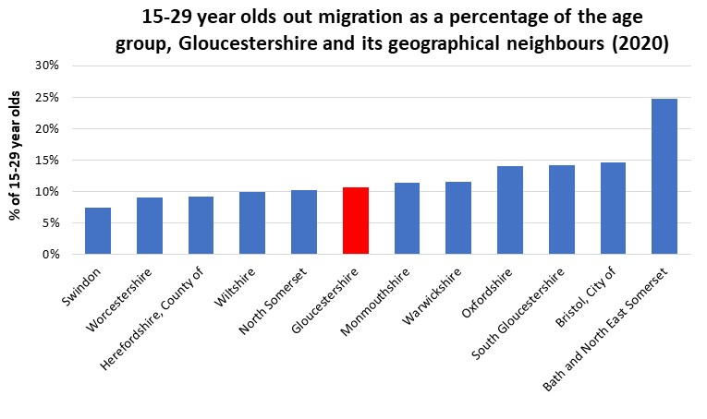
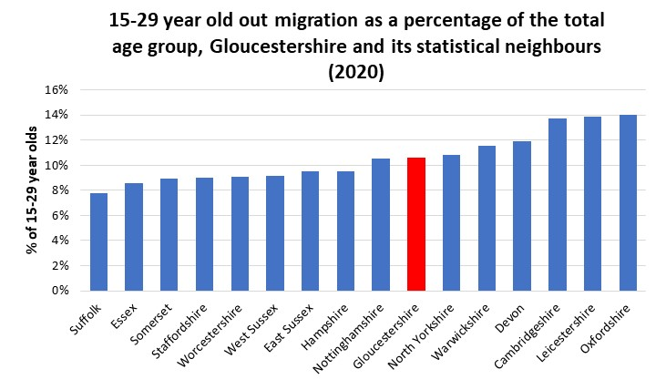





Young people
Where do people move to?
Bristol
684 moves
Oxfordshire
464 moves
Cardiff
461 moves
Worcestershire
431 moves
South Gloucestershire 403 moves
Notes:
In 2020 Gloucestershire has a similar proportion of its 15-29 year olds leaving the county as its geographic and statistical neighbours, it is not an outlier.
The top 5 county and unitary authorities for Gloucestershire 15-29 year olds were: Bristol, Oxfordshire, Cardiff, Worcestershire and South Gloucestershire, this was followed by Devon, Birmingham, and Wiltshire, BANES and Hampshire. London does not feature in the top 10 because it is split into separate boroughs, however if you combined all London boroughs this would be the biggest destination with around 1188 moves

Slide 4
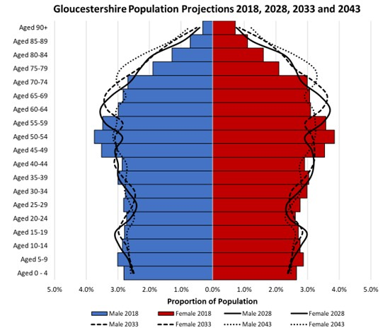

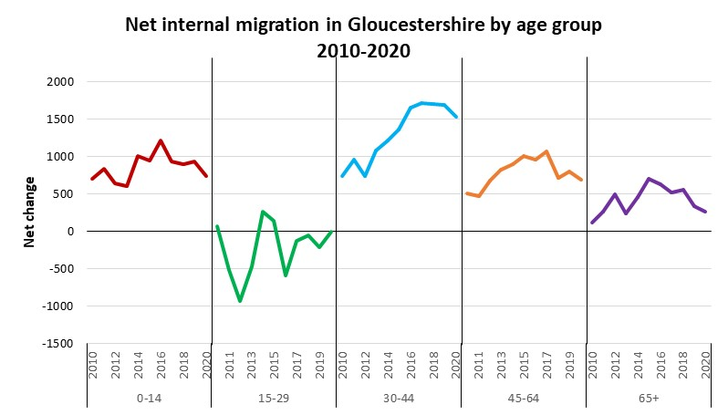
Total Population
Gloucestershire’s population is ageing
By 2043 there will be 80 dependents for every 100 working age people
By 2035 there will be more jobs than working age people
Notes:
Looking at how the 15-29 year old age group compares to other age groups, you can see the 15-29 year old age group is the only age group that sees the county losing more people than it gains.. Amongst all other age groups we have more people moving into the area than leaving. In general, the age group to experience the highest net inflow of migrants each year has been the 30-44 group whereas, the 65+ age group has had the lowest net positive inflow of migrants.
Despite this we do need to recognise Gloucestershire has an older population than nationally, with those aged 65+ accounting for 21.7% of the population, higher than the national average of 18.7%. Projections also suggest this trend will continue with Gloucestershire’s working-age population projected to decrease from 60.7% in 2018 to 55.7% in 2043. This changing population structure has implications for Gloucestershire’s economy. Gloucestershire’s dependency ratio (which is the ratio of people aged 0-16 and 65+ to the working age population) is projected to increase, by 2043 for every 100 people of working age, there will be 80 people reliant on them this compares to 65 in 2018, placing greater pressure on the working age population
The changing population structure may have implications for the workforce and recruitment, by 2035 the number of jobs in the county is projected to exceed the number of working age people posing a challenge for delivering future growth,.

Slide 5
Casualty Statistics

Slide 6
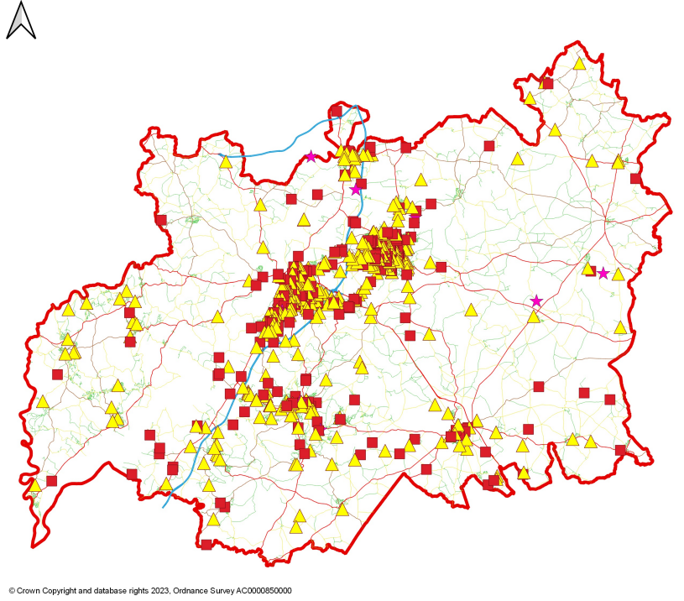
County
Serious
Slight
Fatal

Slide 7
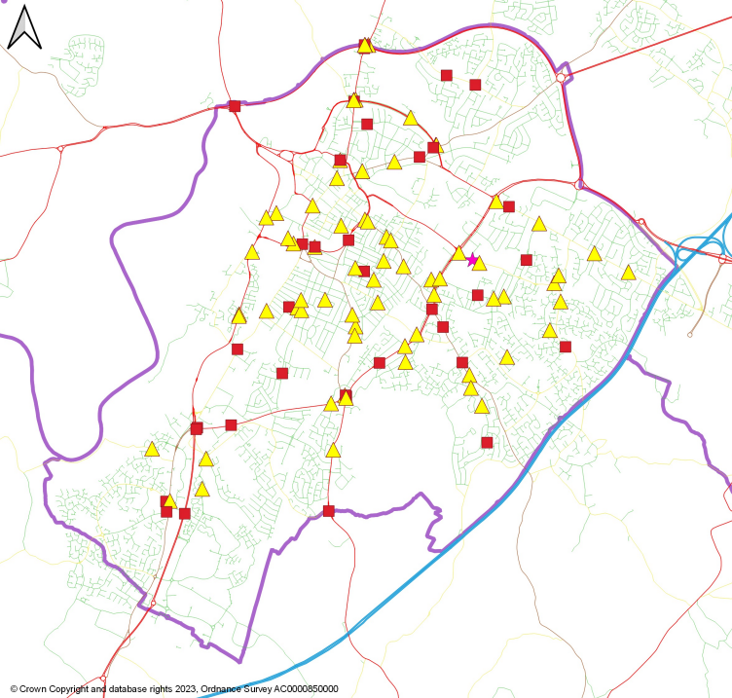
Gloucester
Serious
Slight
Fatal

Slide 8
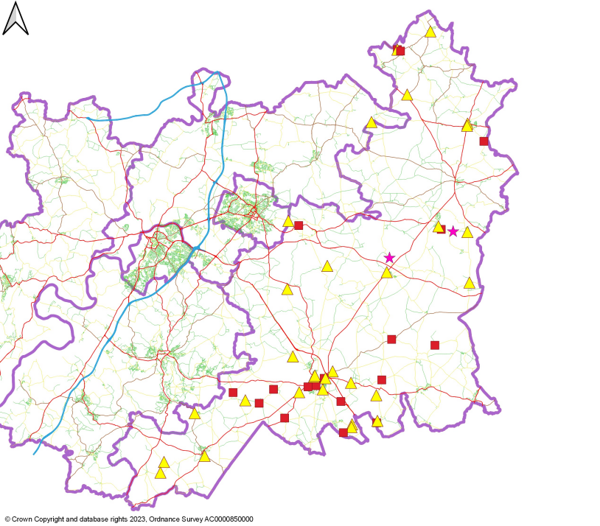
Cotswold
Serious
Slight
Fatal

Slide 9
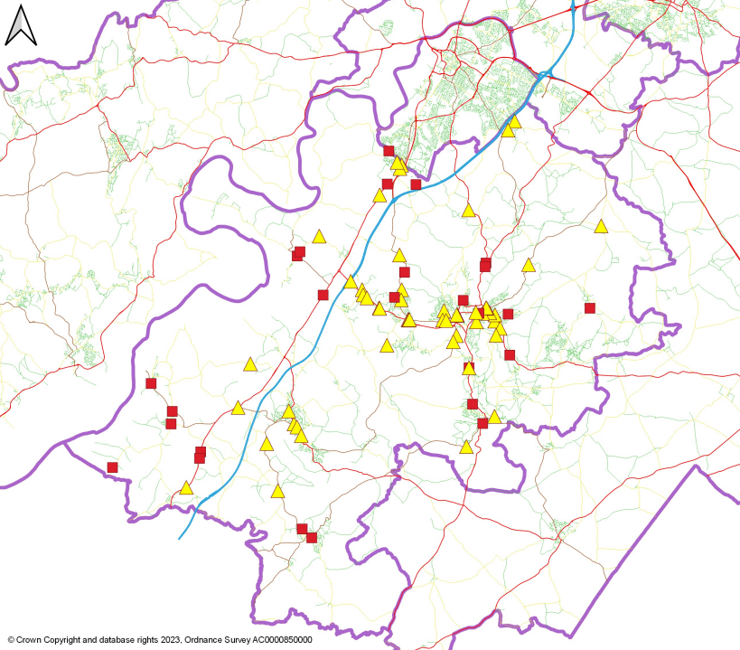
Stroud
Serious
Slight
Fatal

Slide 10
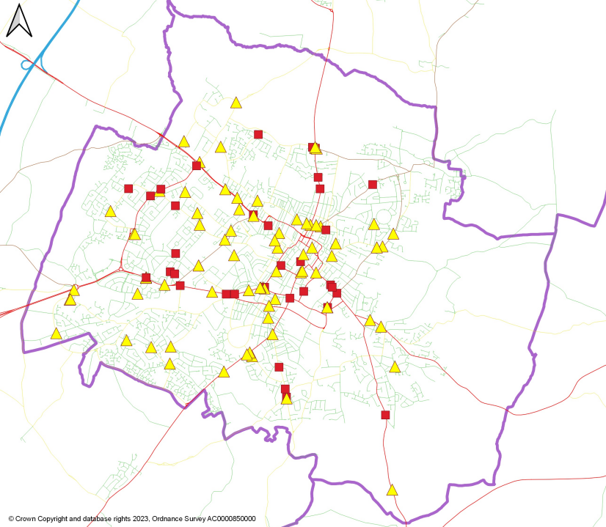
Cheltenham
Serious
Slight
Fatal

Slide 11
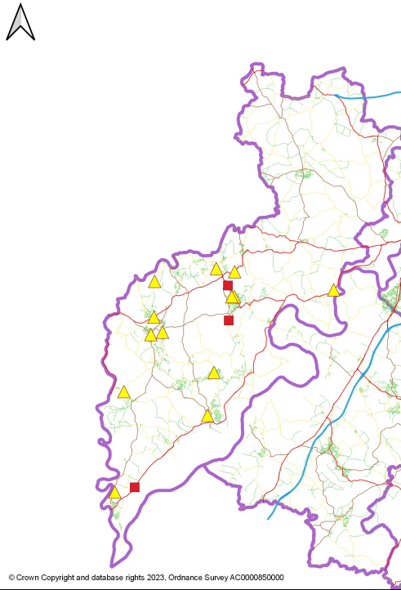
Forest of Dean
Serious
Slight
Fatal

Slide 12
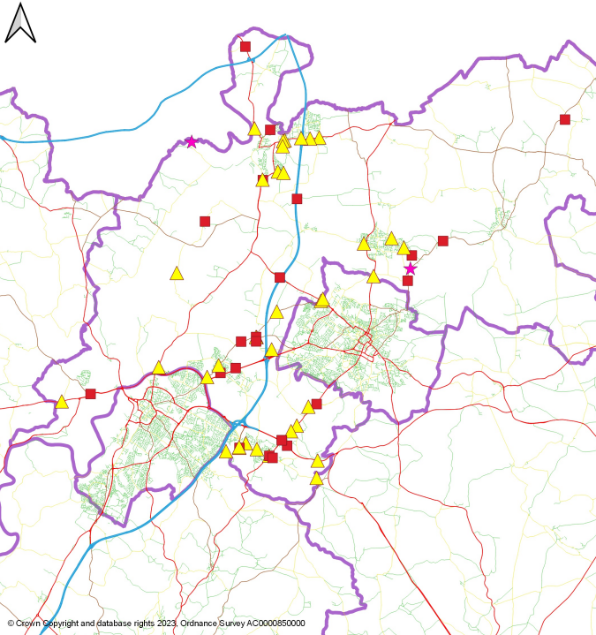
Tewkesbury
Serious
Slight
Fatal

