Slide 1
Gloucestershire County Council
Cycling Forum

Slide 2
Agenda
Welcome and Introductions………………………….
The purpose of the Cycling Forum and the Cycling Advisory Group………………………………………..
GCC Cycling strategy and ambitions for the future
The role of cycling in our economy…………………
Breakout groups: influencing and marketing ……….
Future engagement…………………………………..
AOB…………………………………………………....
(Nigel Moor)
(Sarah Williams)
(Sarah Williams and Alan Bullock)
(Neil Hopwood)
(Nigel Moor)
(Sarah Williams)
(Nigel Moor)

Slide 3
Item 1. Welcome and Introductions
Nigel Moor, Chair

Slide 4
Item 2. The purpose of the forum and CAG
Sarah Williams, Transport Planning
What is the Cycling Advisory Group?
The purpose of the Cycling Forum
Representation
  Leisure
  Community
  Commuting
  Are these representative categories? – to discuss in breakout groups under Item 5.
Notes:
Cycling Advisory Group Strategic meetings
Held: Quarterly
Purpose:
to provide strategic direction and support to GCC cycling projects/schemes.
to act as a Critical Friend, providing feedback and commentary on schemes, and strategic cycle ambitions and policies.
to support and cooperate to improve the quality of provision for cyclists,
to encourage more people to ride more often
Cycling forum – the ideal of which has been evolving throughout 2022
Held: Tri-annually
Purpose:
to ensure the voices of all parts of society are being recognized
to support and cooperate to improve the quality of provision for cyclists
to appoint representatives onto the Cycling Advisory Group
to encourage more people to ride more often
to share a vision for cycling in Gloucestershire
Structure of meeting:
An annual gathering, with guest speakers, to share current thinking and case studies from professional and local backgrounds. This forum would allow an inclusive learning opportunity for all parties with the opportunity to hear about cycling for the perspective of local people, from cycling groups to education specialists, protected characteristics and beyond. Guest speakers would be followed by breakout workshop(s) and finish with a Q&A and feedback session to ensure everyone has had the opportunity to be heard. The Forum will also become a core consultation group for the development of cycling plans across the county.

Slide 5
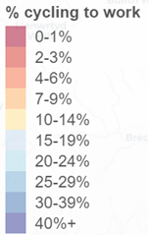
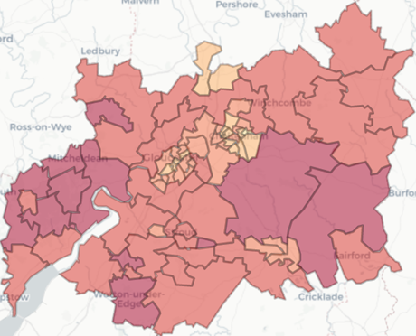
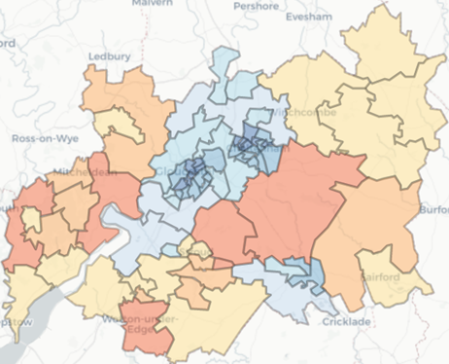
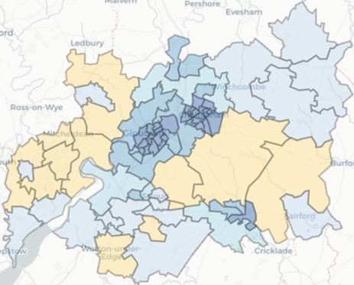
Item 3. Cycling strategy & ambitions for the future
Propensity to Cycle tool – Scenarios for Gloucestershire
The path to carbon zero
  Gloucestershire targets:
  Net zero by 2045
  80% emissions reduction by 2030
  Indicative scenario to reach targets:
  300% increase in cycling by 2030
  We need excellent active travel provision:
  ‘Go Dutch’ for all routes (infrastructure and culture as in Netherlands, but UK topography and average trip length)
  and widespread e-bike use
2011
Go Dutch
E-bike
Notes:
Gloucestershire targets
Net zero by 2045
80% emissions reduction by 2030
GCC commissioned a study to identify the county’s path to achieve carbon zero.
The study identified mid length trips from rural districts as the highest carbon contributors.
Indicative scenario to reach targets:
This would require a 300% increase in cycling by 2030 along with multiple other measures to increase bus patronage and reduce reliance on the private car.
We need excellent active travel provision:
To achieve or targets and increase active travel we need ‘Go Dutch’ scenarios for all routes (i.e. infrastructure and culture as in Netherlands, but UK topography and average trip length)
and widespread e-bike use

Slide 6
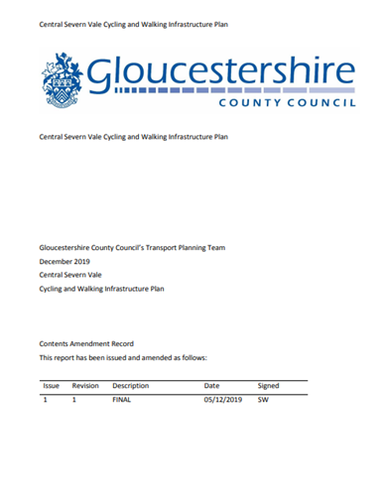


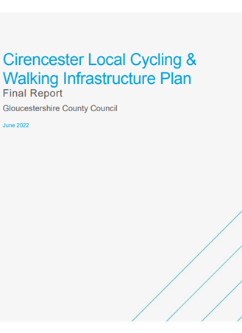

Item 3. Cycling strategy & ambitions for the future
County Strategy
2016 Central Severn Vale LCWIP
Policy
Local Transport Plan
Strategy
Funding
Local Cycling and Walking Infrastructure plans
Overarching Cycling Infrastructure Plan
Mini Holland, Active Travel Fund, Capability & Ambition Fund
2021/22 Stroud LCWIP
2021/22 Tewkesbury LCWIP
2022 Cirencester LCWIP
2022 Cam & Dursley LCWIP
2022/23 Gloucestershire Overarching Cycling Infrastructure Plan
Notes:
In order to achieve these targets we have
Capability & Ambition Fund – £500k plus 10%
Active Travel Fund 4 – awaiting guidance
Mini Holland – awaiting guidance
Local Transport Note 1/20 and Highway code updates have shaped schemes we are taking forward

Slide 7
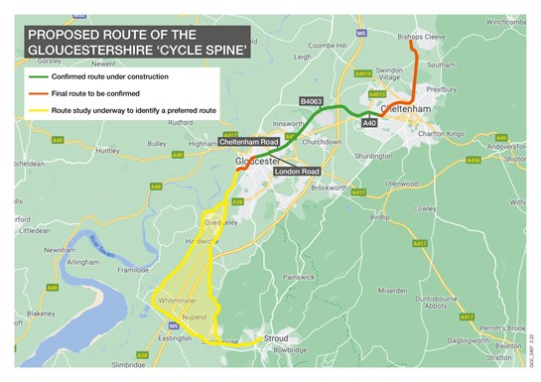
Item 3. Cycling strategy & ambitions for the future
Alan, Bullock, Major Projects
26 mile route of high quality cycle and walking
infrastructure reflecting County’s most ambitious
plans ever with over £40 million secured to date
LTN1/20 compliance with high Cycling Level Of
Service and Junction Assessment Tool scores
Prioritisation to ‘off road’ provision consistent with
LTN1/20 supporting new cyclists age 8-80,
supporting the young, elderly, women and
disabled who are currently underrepresented

Slide 8
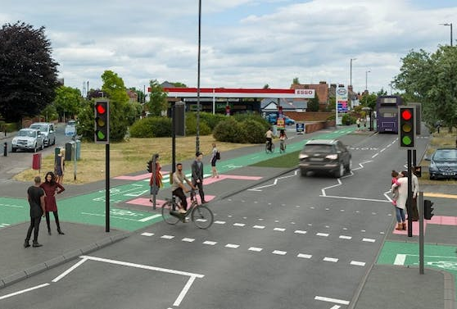
Item 3. Cycling strategy & ambitions for the future
Alan, Bullock, Major Projects
Ensuring extensive consultation and engagement
remains integral to the design and delivery process
Considering post works feedback and assessing
pre and post works data and feedback
Continuing to seek critical friend design input
Publication of Gloucestershire Active Travel Advice
Note that will bring consistency and share best practice

Slide 9
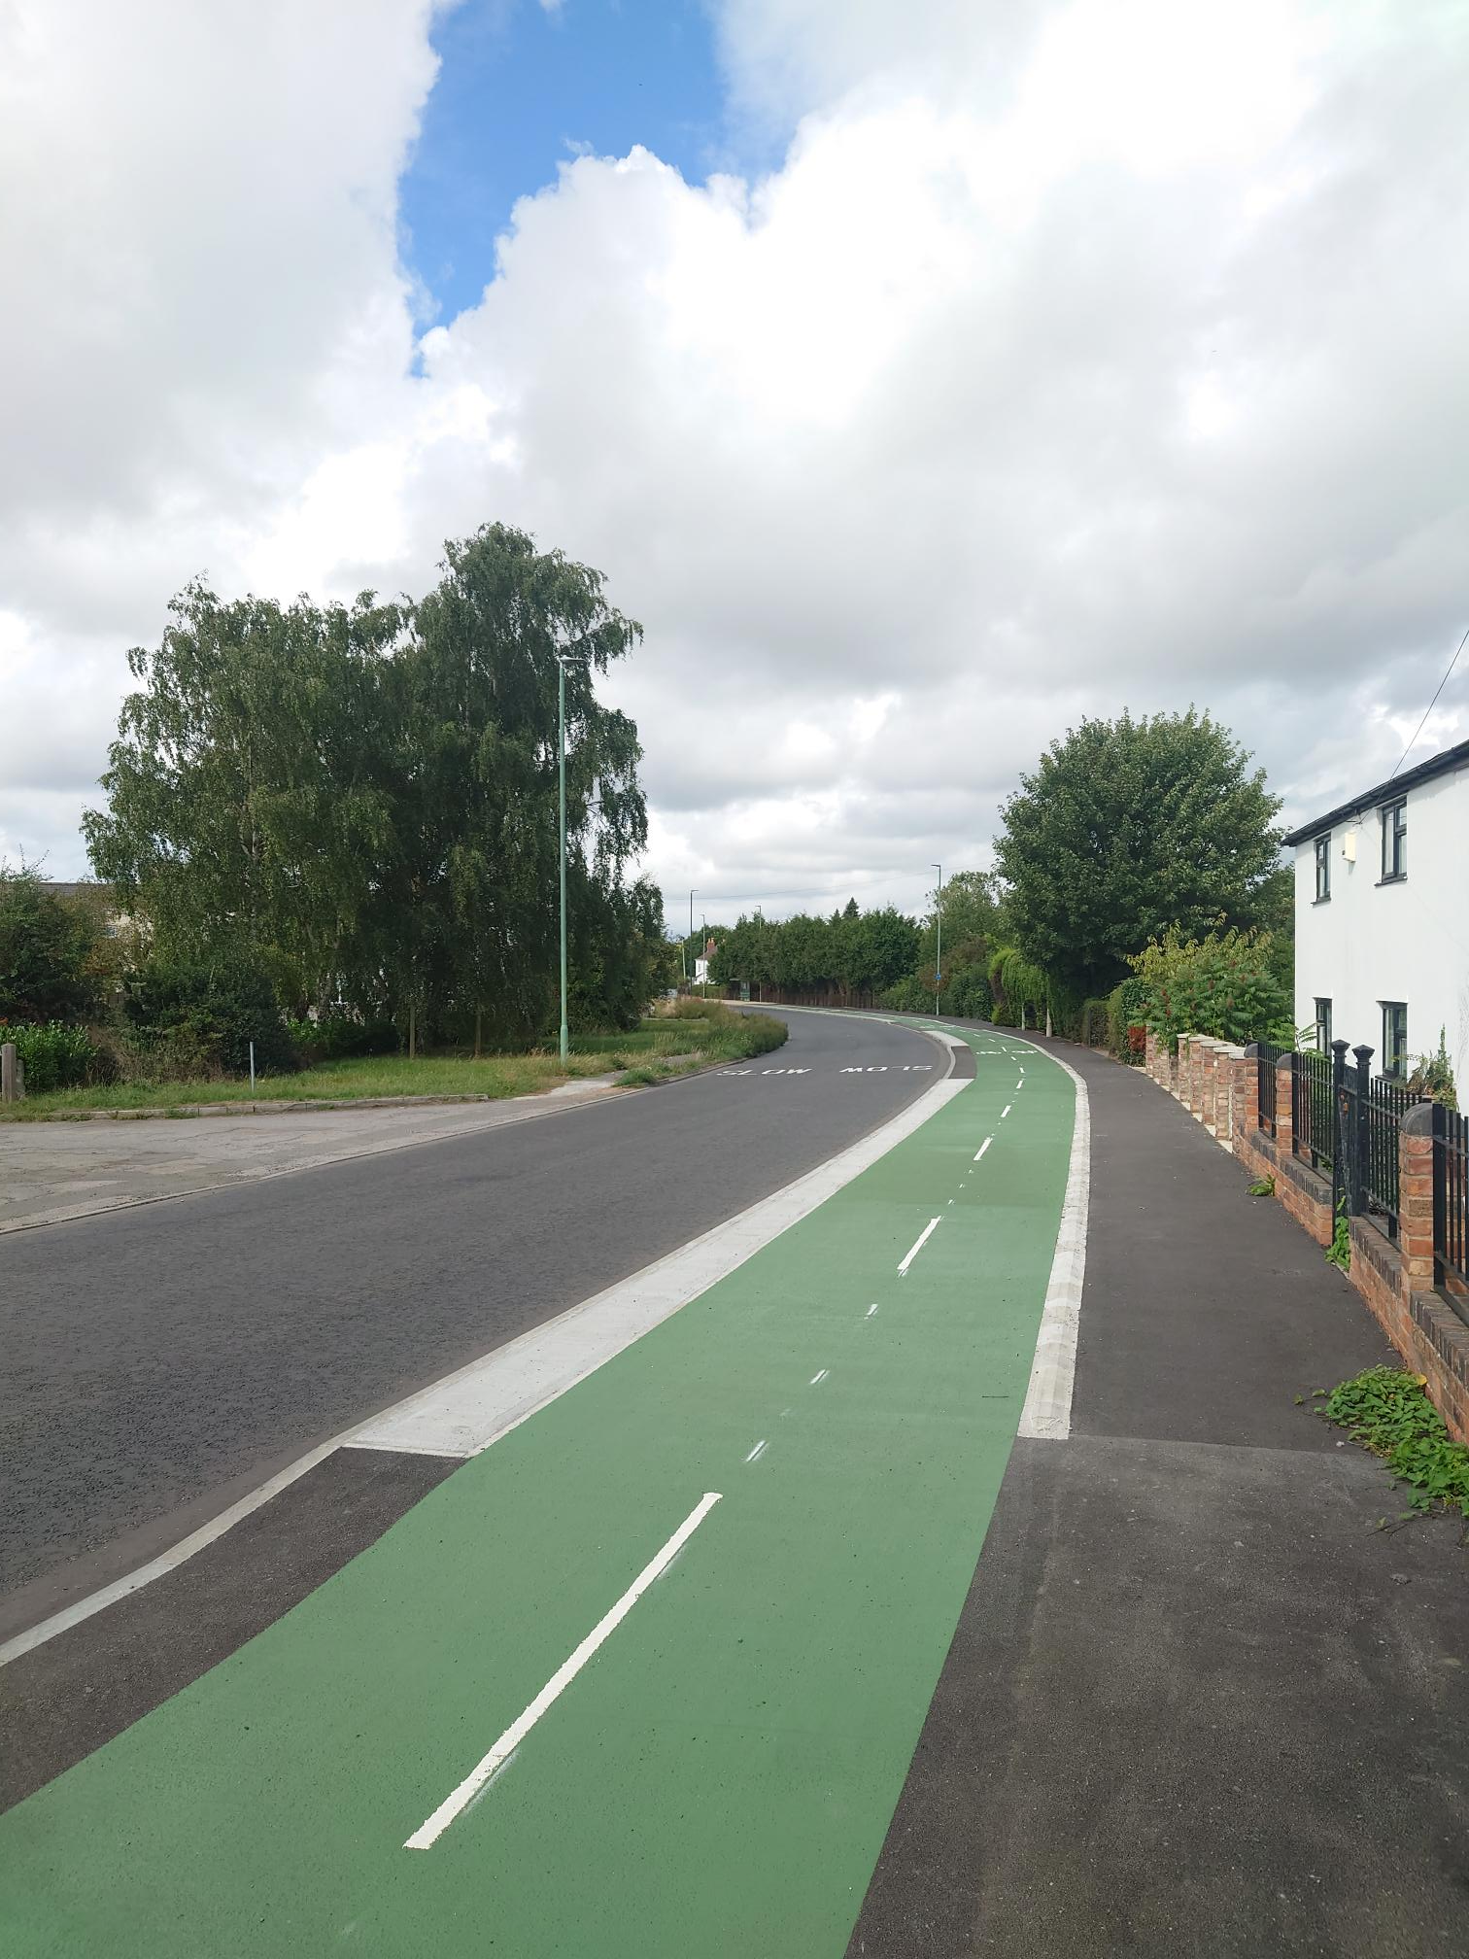
Item 3. Cycling strategy & ambitions for the future
Alan, Bullock, Major Projects
First two phases of B4063 Gloucester to Cheltenham
Cycle route now complete between M5 and Arle Court,
this links with the completed West Cheltenham Walking and
Cycling Improvements
Sections between Elmbridge and M5 now being delivered
Sections through Gloucester City Centre and Cheltenham
to Bishops Cleeve currently being developed
GCC recently secured a ‘high’ level 2 Self Assessment
score from Active Travel England with feedback indicating
further delivery could secure a level 3 score in future years

Slide 10
Item 4. The role of cycling in our economy
Neil Hopwood, Local Enterprise Partnership
\\SVRSHIR160\sarahwilliams$\Desktop\The Role of Cycling in The Economy.pptx

Slide 11
Item 5. Breakout groups
Sarah Williams, Transport Planning
Influencing and marketing -
How can we disseminate new advice on cycling to the county’s riders
How can we embed the principles of the new Highway Code amongst road users to better acknowledge cyclists and pedestrians?
How do you feel the needs of different abilities of cyclist are best integrated?
Are ‘leisure’, ‘community’ and ‘commuting’ representative categories of cycling journeys?

Slide 12
Item 6. Future engagement
Sarah Williams, Transport Planning
Nominations onto CAG
  Write to Sarah.Williams3@gloucestershire.gov.uk if you want to represent the group on CAG
    Whilst we appreciate people generally fit into many groups, which group describes your general style of cycling; leisure, community or commuting?
    Which group do you feel you can best speak on behalf of as a forum representative?
  Nominees introduce themselves at an online meeting of the forum (date to be arranged)
  Forum members can vote for nominees

Slide 13
Item 7. Any other business
Nigel Moor, Chair

