Slide 1



Drug and Alcohol
Needs Assessment
2026

Slide 2

Contents
01. Strategic Context
National priorities
Our approach to meeting the Harm to Hope aims
02. Local and National Intelligence
The national picture
What the local data is telling us
Overview of delivery: Pillars 1, 2, and 3
Learning from partners and service users
03. Our Gloucestershire Priorities and Recommendations
How we developed our priorities
Recommendations
How we will deliver change
02
Drug and Alcohol
Needs Assessment

Slide 3
“There is a very tragic human story behind this analysis. Drug deaths in 2018 were the highest on record. Since 2012 heroin-related deaths have more than doubled, while deaths involving cocaine have increased five-fold. We have the highest number of rough sleepers dying on our streets from drug poisoning since records began. Long-term drug users are cycling in and out of our prisons, at great expense but very rarely achieving recovery or finding meaningful work. Many of their children are taken into care. Problem drug use is highly correlated with poverty, and these problems blight our most deprived communities”
Section 1 - The Strategic Context
This Needs Assessment has been developed to inform commissioning of community-based alcohol and drug use treatment services in Gloucestershire. It will guide the work of the Gloucestershire Combating Drugs Partnership and provide an evidence base to support the development of services which best meet the needs of our population. It is supported by an action plan which sets out how we will collectively deliver and monitor progress over the next 3 years.
- Dame Carol Black , Review of Drugs February 2020
(Professor Dame Carol Black was appointed by the Home Office and the Department of Health and Social Care to lead a major national review into drug treatment, recovery and prevention with the aim that vulnerable people with substance misuse problems get the support they need to recover and turn their lives around)¹
This Needs Assessment has been developed to inform commissioning of community-based alcohol and drug use treatment services in Gloucestershire.
It will guide the work of the Gloucestershire Combating Drugs Partnership and provide an evidence base to support the development of services which best meet the needs of our population. It is supported by an action plan which sets out how we will collectively deliver and monitor progress over the next 3 years.
03
Drug and Alcohol
Needs Assessment

Slide 4

Section 1 - The Strategic Context
1. Breaking drug supply chains – through reducing the amount of drugs entering the country, closing county lines and disrupting drug gang operations.
2. Delivering a world-class treatment and recovery system – through implementing Dame Carol Black’s key recommendations, better integrating services, rebuilding the Substance Misuse workforce , supporting service users with health, housing and employment.
3. Achieving a generational shift in demand for drugs – through increasing intervention and prevention schemes in schools, supporting young people and families at highest risk of substance misuse.
National Priorities
In December 2021, the Government launched its 10-Year National Drug Strategy - From Harm to Hope.
Its focus is on delivering three strategic priorities:
04
Drug and Alcohol
Needs Assessment

Slide 5
Section 1 - The Strategic Context
The Gloucestershire Combating Drugs Partnership also have a significant role in leading and monitoring the impact of spending under the grant. This is an OHID-mandated senior strategic group, made up of partners from across the criminal justice system, health and local authority as well as regional partners and the voluntary and community sectors. Operational delivery is managed by commissioners at Gloucestershire County Council and through four sub-groups – Adult Treatment; Children and Families; Data; and Enforcement.
Adult treatment and recovery services in Gloucestershire are commissioned by Gloucestershire County Council and delivered by Via Care Ltd. This arrangement started in April 2024.
Dedicated services for children and young people are provided by the Youth Support Service at an annual cost of around £340,000 per year.
We also contribute to the funding of related services such as the hospital alcohol liaison team and specialist midwives at Gloucestershire Hospitals NHS Trust and co-occurring conditions work which links services for people with mental ill health and substance use needs delivered by Gloucestershire Health & Care NHS Foundation Trust.
Since our last Needs Assessment was completed, we have commissioned and successfully transitioned to a new treatment provider. This new drug and alcohol service started on 1st April 2024 and is provided by Via Care Ltd ^{2, 3, 4, 5} in partnership with The Nelson Trust, Emerging Futures, P3, Intuitive Thinking and Young Gloucestershire . Via offer a range of interventions to support people with drug and/ or alcohol needs including structured treatment, access to residential rehab and detox, 1:1 counselling, group work and medical support.
Our approach to meeting the From Harm to Hope aims
Key points
Gloucestershire spends around £7.81m directly funding annually on providing substance use treatment and recovery services. This funding comes from the Public Health Grant, specific central government drug and alcohol grants and contributions from local partners such as the Office of the Police and Crime Commissioner
The management of these grants and their impacts is overseen and co-ordinated by Gloucestershire County Council’s Public Health team. In future, all funding for this area of work will be through the Public Health grant and will be the responsibility of the Director of Public Health.
05
Drug and Alcohol
Needs Assessment

Slide 6
Section 1 - The Strategic Context
This has enabled us to, for example, understand need at a much more local level than previously as well as giving us a more detailed understanding of our treatment population in terms of things like employment and educational status, presentations to hospital and to identify emerging trends. We have also asked key stakeholders and users of our services for their views and experiences to ensure we are capturing both hard intelligence from nationally approved sources as well as qualitative intelligence on the ground in Gloucestershire.
Gloucestershire is a county whose population is growing and ageing faster than the UK average. We have pockets of deprivation and health inequalities, which can be hidden as the county generally enjoys a high standard of living. Approximately 70% of people live in areas classed as ‘urban city or town’ or ‘rural town and fringe’. By contrast, 30% of the county is rural which can make access to services challenging.
Our approach to meeting the From Harm to Hope aims
The commissioning of the service was built upon what the previous Needs Assessment told us, and its development will be informed by the findings of this refreshed Needs Assessment. Where there is evidence of changing need, we will have to consider how to change our services to best respond to shifting demand and opportunities. To give us the most reliable and insightful picture of substance use needs in the county, we have used a wide variety of data, including adding in information from newly available data sources and improved analysis techniques.
06
Drug and Alcohol
Needs Assessment

Slide 7
Gloucestershire:
1.16%
+ 7,656 people
Population estimates (1)
Between mid-2023 and mid-2024
Mid-2024: 669,380
(Mid-2023 661,724)
Sex split
Median age
Broad age groups
43.8 years
51.1%
48.9%
0-15 16-64 65+
Male
Female
17.49% 60.39% 22.12%
Population distribution by deprivation (2)
Population density
District lens mid-2024:
Gloucester: 138,598
Stroud: 125,680
Cheltenham: 121,739
Tewkesbury: 101,949
Cotswold: 91,661
Forest of Dean: 89,753
1.68%
0.98%
0.73%
2.41%
0.16%
0.79%
252 people per square kilometre
IMD 2025 national quintiles
Office for National Statistics https://www.ons.gov.uk/peoplepopulationandcommunity/populationandmigration/populationestimates
Ministry of Housing, Communities and Local https://www.gov.uk/government/statistics/english-indices-of-deprivation-2025 Government

Slide 8
Section 2 - National and local intelligence
Nationally, 5,565 drug poisoning deaths were registered in 2024, which is the highest number of deaths registered in one year since records began in 1993 ⁷.
To address this, the Government published the From Harm to Hope 10-year drugs plan in 2021 which sets out the three strategic priorities around which this Needs Assessment is structured, supported by additional investment.
Drugs - The national picture
In addition, the Crime Survey for England and Wales estimates 8.7% of people aged 16 to 59 years (approximately 2.9 million people) and 15.1% of people aged 16 to 24 years (around 899,000 people) have used "any drug" in the past 12 months ⁹.
This section sets out what the latest available data and analysis is telling us about substance use, prevention and treatment. We have brought a range of data sets together to provide a rich insight into the effectiveness of our work and to draw out opportunities for improvement. It also outlines what we have done since the previous Needs Assessment was developed and what still needs to be done.
According to the latest 2024/25 National Drug and Treatment Monitoring System (NDTMS) data, there were 329,646 adults aged 18 and over in contact with drug and alcohol treatment services, an increase of 6.0% compared to 2023/24 and the highest number of adults in treatment since reporting began.
Nationally, 42% of adults in treatment were there to address problems with opiates. The proportion of new entrants to treatment have climbed for the use of cannabis, powder cocaine and ketamine. While numbers are still small, in 2024/25 there were over 12 times as many ketamine users starting treatment than in 2014/15 ¹⁰.
We know that becoming dependent on drugs or alcohol ruins lives, damages communities and destroys families. They are a major driver of crime and the harms arising from drug misuse are estimated to cost the national economy £19.3 billion per year ⁶.
08
Drug and Alcohol
Needs Assessment

Slide 9
What the local data tells us - Overview
Section 2 - National and local intelligence
Our new provider of substance use treatment started in April 2024 and, as part of the handover of services, completed a data cleansing exercise as well as making some changes to how cases were recorded. This means that the data we now have available is highly reliable, but direct comparisons between the period up to 2024 and afterwards should be made with caution.
Alcohol – The National Picture
Key points¹³,¹⁴,¹⁵
• In 2024/25, we treated 2,399 people in our adult services and 120 in our children and young people services. The current targets as agreed by OHID are 2,521 and 120 respectively so we need to improve our performance for adults to reach our ambitions.
• Gloucestershire’s adult population is older than England’s average, but our treatment population is slightly younger than the national average. The majority of our treatment population is aged 30-34 or 50-54.
• There are almost twice as many men in treatment compared to women (65.4% male: 34.6% female): this has stayed roughly the same over recent years and is similar to the national picture.
• Nationally, there has been no significant change in overall drug use compared to 10 years ago. However, local treatment data indicates there are rising trends in the use of cocaine, cannabis and ketamine so our future activities will need to adapt and take this into account. Consider a recommendation in response to rising trends in use of ketamine etc (Recommendation 1)
There are around 10 million adults in England who drink above the UK Chief Medical Officer’s low risk guidelines, including an estimated 587,000 who are dependent on alcohol.
Across the country, 105,000 people were receiving local authority commissioned treatment last year, of whom, 30,000 used drugs alongside alcohol. People in treatment for alcohol alone make up the second largest group (30%) of adults in treatment, with the numbers rising from 86,257 in 2022 to 99,955 in 2025.
There were 340,000 hospital admissions in 2023-24¹¹ where the primary diagnosis was a condition related to alcohol consumption, including 27,000 for alcoholic liver disease¹².
09
Drug and Alcohol
Needs Assessment

Slide 10
• Gloucestershire’s proportion of opiate, non-opiate and alcohol users retained in treatment all exceed the England average. There is still, however, an estimated unmet treatment need of around 55.3% for OCUs (opiate and crack users) and 82.6% for alcohol dependents (2024/25)¹⁶ so we have more work to do to reach more people living with dependency.
• People from minority ethnic groups make up 5.7% of our total treatment population. This is in line with the 2021 Census population for Gloucestershire.
Section 2 - National and local intelligence
What the local data tells us - Treatment
Table 2: Ethnic breakdown of the drug and alcohol treatment population, compared with the England and the Gloucestershire 2021 Census population ^{17, 18}
Row Labels | Gloucestershire treatment population | England treatment population | Gloucestershire Census 2021
Asian, Asian British or Asian Welsh | 0.8% (0.9%) | 4.0% (4.1%) | 2.6%
Black, Black British, Black Welsh, Caribbean or African | 1.4% (1.5%) | 3.1% (3.2%) | 1.1%
Mixed or Multiple ethnic groups | 2.7% (2.8%) | 2.8% (2.8%) | 1.3%
Other ethnic group | 0.6% (0.6%) | 1.0% (1.0%) | 0.6%
White | 90.4% (94.2%) | 86.6% (88.8%) | 94.3%
Unknown ethnicity | 2.3% | 0.4% | -
Inconsistent/Missing | 0.3% | 0.8% | -
Not stated ethnicity | 1.5% | 1.3% | -
Grand Total | 2,399 | 327,827 | -
Key points continued
• Almost a third of Gloucestershire’s treatment population tells us that they have a behavioural disability (29.7%), and 1 in 2 clients have a physical or mental disability. Consider a recommendation re response to better meeting co-existing Mental Health/substance use needs (Recommendation 2)
• There are an estimated ~5,500 people in Gloucestershire who are alcohol dependent.
• There are an estimated 2,899 (2022/23) opiate and crack users in the county. The treatment penetration rate is 57.9 %.
N.B. (brackets) indicate the proportions calculated when only people with known ethnicities are taken into account.
10
Drug and Alcohol
Needs Assessment

Slide 11
NDTMS: National Drug Treatment Monitoring System 2024/25- Gloucestershire adults aged 18+
2,399 adults in treatment
849 treatment exits
947 new clients
480 (57%)
incomplete
284 (33%)
completed
85 (10%)
transferred
Source of referral to treatment
Sex split
Age
73.5%
of the treatment population is aged 30-54
52%
made by self, family and friends
34.6%
65.4%
Male
Female
Sexual orientation
Ethnicity
Disability status
6.9%
identified as either gay/lesbian, bisexual or other*
1 in 20
clients were from a minority ethnic background*
1 in 2
clients have a physical and/or mental disability*
Data source: NDTMS *where the characteristic is known

Slide 12
We have also included qualitative data from service users and partners to ensure we are able to understand not only what we are doing, but how well (or not) this is working for people across
Section 2 - National and local intelligence
Key points
We are now able to map service users at a greater level of detail than was previously possible, down to Lower Super Output Area¹. This shows us where our treatment population lives and enables us to ask what the best way is to deliver services to as many people as possible within the resources available.
More detailed information relating to health has been included in our analysis. This includes hospital admissions and attendances relating to drug poisoning and substance misuse which, when read in conjunction with data such as that relating to drug deaths provides us with additional opportunities to intervene earlier to prevent harm.
Local and national data both tell us that mental ill health and substance use are strongly associated (see page 36). Our Gloucestershire Drug and Alcohol Services Survey (Autumn 2025) asked stakeholders working with those that have experienced substance use, “What are the problems, gaps and challenges in tackling drug and/or alcohol related harm in Gloucestershire?”. One of the predominant themes they identified was ‘Dual Diagnosis’ stating, for example, "Services often help with mental health struggles OR addiction .”
¹ A Lower-layer Super Output Area (LSOA) is a small geographic unit used for statistical analysis in England and Wales. LSOAs were introduced by the ONS (Office for National Statistics) for the Census and are designed to contain a consistent population size, typically around 1,000-3,000 residents or 400-1,200 households.
What the local data tells us – New Insights
The infographic on the previous page shows a high-level outline of Gloucestershire’s adult treatment population, further details of which will be explored below. In common with national norms, the majority of people accessing our services are male and between the ages of 30 and 54. Over recent years, our treatment population has maintained between 2,000 and 3,000 people.
This refreshed Needs Assessment, as well as using data which outlines our overall performance and need as in previous versions, includes newly available data which we have used to improve our understanding of the treatment population and to identify areas of good performance as well as identifying areas where we need to improve. Newly available quantitative data includes information about: where our service users live and where they access treatment; hospital admissions and attendances; and personal characteristics such as employment and education status.
12
Drug and Alcohol
Needs Assessment

Slide 13
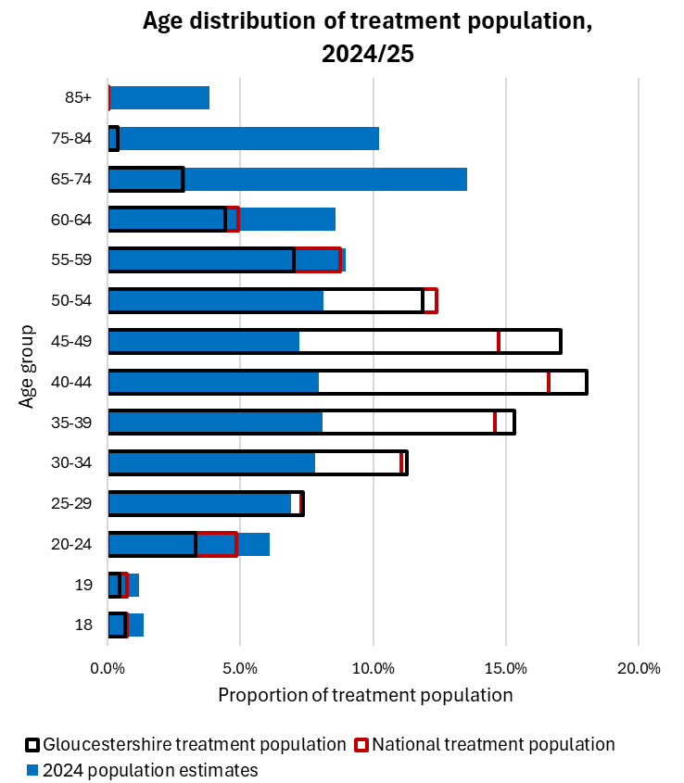
Section 2 - National and local intelligence
What the local data tells us - Age
Gloucestershire has a slightly younger treatment cohort than the national cohort although Gloucestershire has a lower proportion of its treatment population aged 20-24 than nationally.
The majority of the treatment population is aged between 30-34 and 50-54.
Compared to the population structure of Gloucestershire (mid-population estimates 2024), there is an overrepresentation of people in the treatment population aged 25-29 to 50-54.
13
Drug and Alcohol
Needs Assessment

Slide 14
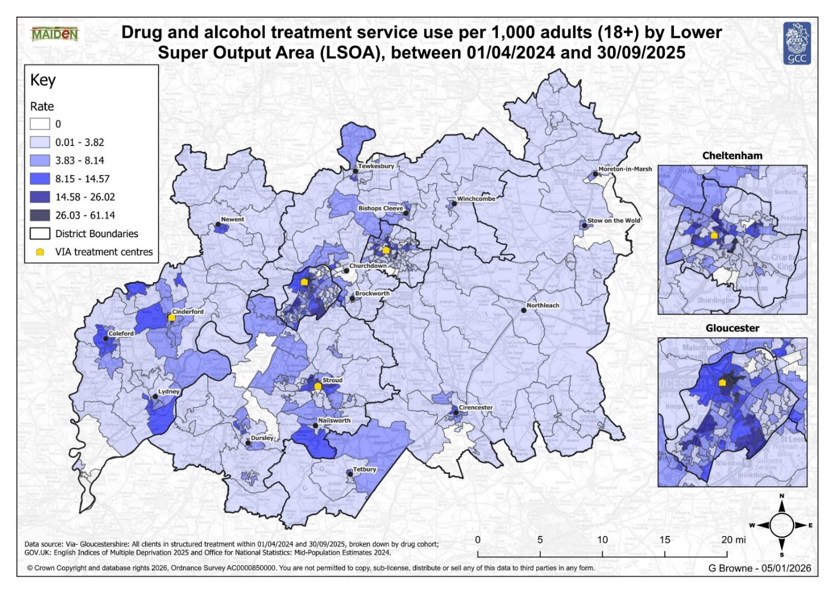
Figure 2: Drug and alcohol treatment service use per 1,000 adults (18+) by Lower Super Output Area (LSOA), between 01/04/2024 and 30/09/2025
Section 2 - National and local intelligence
This map shows the home location of drug and alcohol treatment service users in Gloucestershire. It represents a degree of detail which we have not been able to access previously and shows us that users are predominantly centred around our urban areas and maps closely to the locations of our treatment providers. However, we can also see that there are a number of areas which show a considerable level of use/need outside those main centres.
We will need to explore how we can respond to this evidence of need within our available budget and be open to adapting our service provision, processes and visibility more widely across the county. Further detailed maps are available in Section 2, Pillar 2 below.
The Drug and Alcohol Services Survey completed by stakeholders in Autumn 2025 also told us that ‘Rural Access to Services’ was a predominant theme. When asked “What are the problems, gaps and challenges in tackling drug and/or alcohol related harm in Gloucestershire?” stakeholders’ responses included the following comments:
What the local data tells us - Location
“Those in more rural areas do not get a very good service or are expected to travel.”
“…dispersed rural nature of the county makes it challenging to ensure equal resourcing and access across the county.”
“Poor availability/visibility of services in rural areas .”
14
Drug and Alcohol
Needs Assessment

Slide 15
Figure 2: Drug and alcohol treatment service use per 1,000 adults (18+) by Lower Super Output Area (LSOA), between 01/04/2024 and 30/09/2025

Slide 16
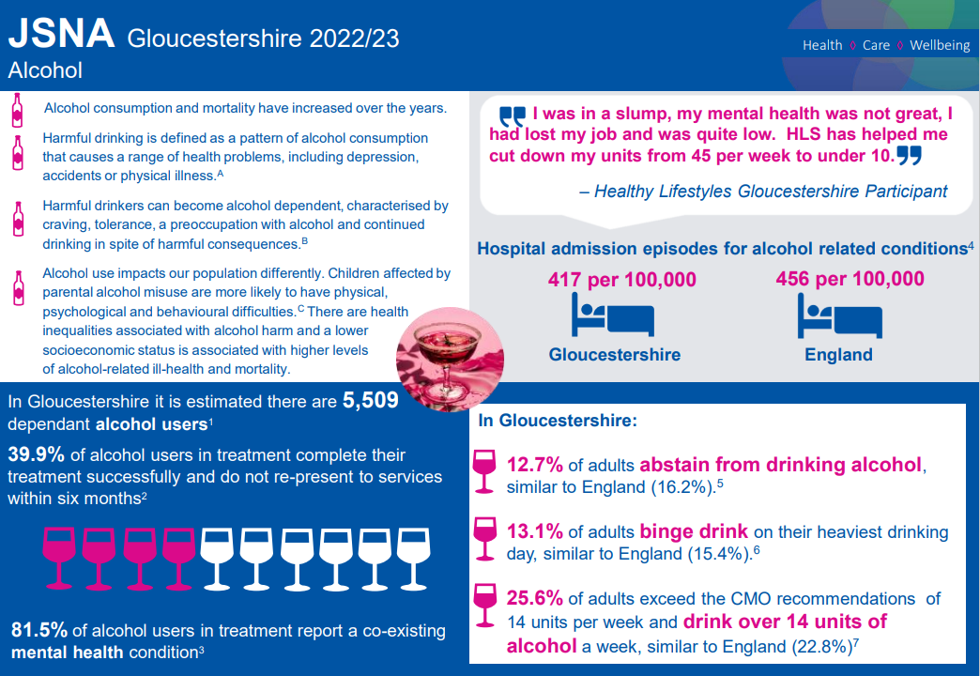
Section 2 - National and local intelligence
What the local data tells us - Alcohol
In Gloucestershire there is an estimated unmet need of 82.6% for Gloucestershire adults with alcohol dependency which is slightly higher than the national average (75.9%). While it is important to note that this is based on 2019/20 data, this would equate to 5,452 adults dependent on alcohol in Gloucestershire who are not engaging with treatment and recovery services.
Young females have a significantly higher hospital admission rate in Gloucestershire for alcohol-specific conditions compared to males. In 2021/22 to 2023/24, the female rate was 50.5 admissions per 100,000 young people aged 0-18 and the male rate was 13.2 admissions.
Figure 3: JSNA Gloucestershire 2022/23: Alcohol ¹⁹
This infographic taken from the Gloucestershire Joint Strategic Needs Assessment and outlines alcohol use and some of its effects in the county.
15
Drug and Alcohol
Needs Assessment

Slide 17
Substance misuse, both drugs and alcohol, are closely associated with crime. For instance, alcohol use is a common feature within violent offences, including domestic abuse cases. Violence is also a feature of illicit drug markets, particularly as a result of the competition and exploitation within the supply chain, such as ‘County Lines’ and Organised Crime Groups. Problem heroin and crack use is major driver of crime, with roughly half of all acquisitive crime (Ref .) being associated with the dependent use of these drugs.
However, whilst these associations are well known, at a local level our ability to measure the extent to which alcohol and or drugs are implicated in or causative within a crime is significantly limited. There are elements which due to the sensitivity of ongoing operations and the need to maintain their integrity, cannot be reported on in public. But within those caveats, we can look at some specific drug offences with clarity and explore our performance to address the role that substance misuse plays in crime.
Section 2 - National and local intelligence
Overview of delivery: Pillars 1, 2 and 3
Pillar 1 – Breaking drug supply chains
This section explores data relating to the supply of drugs in the county and the impacts on the local population.
The aims of Pillar 1 are to break supply chains, disrupt county lines, and to reduce crime associated with drugs and alcohol. Pillar 1 is a collaboration between multiple agencies: the police, the National Crime Agency, a wide range of Government departments, local government agencies, and voluntary and community sector organisations to target and tackle the supply of drugs in Gloucestershire.
16
Drug and Alcohol
Needs Assessment

Slide 18
Priority Action | Outcome
Gloucestershire Constabulary will set a target for 10% year on year increase of drug seizures. | Despite competing pressures and priorities within the Constabulary, during 2023-2024, the Serious & Organised Crime Unit concluded the following successful covert operations: Operation Allaho – 2kg of cocaine and heroin seized Operation Pontus – 11 offenders sentenced to over 50 years for conspiracy to supply Class A drugs Operation Serena – seizure of 1kg of cocaine Operation Pecan – medium-term undercover operation gathering intelligence regarding drug supply and the exploitation of vulnerable people in Gloucester and Cheltenham Operation Koko – 4 offenders prosecuted for drug supply
Gloucestershire Constabulary will understand the intelligence that relates to county lines and undertake targeted, disruptive work. | Gloucestershire were the lead Force for the latest Op Scorpion event – co-ordinating disruptive work across the whole of the south west.
Gloucestershire Constabulary will work with partners to understand intelligence and disrupt activity around drug supply and undertake initiatives to reduce it impact in communities. | The Constabulary has increased the use of the “Op Pester” tactic – a communication tool used to contact recipients of bulk messages and divert to partner agencies and seek help for drug use / addiction.
Section 2 - National and local intelligence
Pillar 1 – Breaking drug supply chains
What have we delivered since the last Needs Assessment?
Gloucestershire Constabulary has an allocated Drugs and County line intelligence threat desk, that reviews and triages relevant intelligence. This enables an on-going focus on the harm to youths through exploitation by both internal and external county lines as well as pro-active work to disrupt drug supply on street level.
We have looked to better understand those at risk of exploitation working with adult social care, prioritising action from reports submitted from partners – improving joined up thinking around frequent missing people being at risk of exploitation. All missing people are discussed on the daily management meeting, chaired by a senior leader.
17
Drug and Alcohol
Needs Assessment

Slide 19
Crime Survey for England and Wales 2024/25 - national data
8.7%
of adults aged 16-59 used illicit drugs in the past year
Decreasing trend in frequent drug use
3.3%
of adults aged 16-59 used class A drugs in the past year
Drug obtainment method
Trends in drug use- 2024 to 2025
Alcohol consumption
43.1% drugs obtained via a friend, neighbour or colleague
Nitrous oxide
New psychoactive substances
(all other substances used were similar to 2024)
Drug use is higher amongst people that drink alcohol regularly
Age
Sexual Orientation
Mental well-being
Young people (aged 16-24) are more likely to have taken drugs in the past year compared to people aged 25-69
LGB+ people are over twice as likely to have taken drugs in the past year compared with straight people
People with low happiness* are around 2.5x more likely to have taken drugs in the past year
*self-reported score
Data source: Crime Survey for England and Wales 2024: Drug misuse - ONS Centre for Crime and Justice.
N.B. It is important to note that personal and household characteristics are not necessarily related to drug-use.

Slide 20
Section 2 - National and local intelligence
Nearly two thirds (63.4%) of Class A drug possession offences were in Gloucester (43.9%) and Cheltenham (19.5%) which is a very similar to the pattern seen within treatment drug treatment demand. A similar picture is seen for Class B offences with arrests concentrated in Gloucester (40.1%) and Cheltenham (20.6%). The Forest of Dean and Cotswold areas both see the lowest level of arrests for Class A and B offences; with Forest of Dean having the lowest proportion of Class A offences (4.9%) and Cotswold having the lowest proportion of Class B offences (7.2%).
Most arrests result in no charges being brought, just 14.1% were charged with an offence, with out of court resolutions (Community Resolutions or Conditional Cautions) being the preferred remedy for possession of Class B and C drugs.
Criminal Justice agencies are a key referral route into drug and alcohol treatment. In many cases the people identified within the cells are already known to the adult treatment service. For instance, between January and the end of March 344 people were screened, 25% were open to Via at the time of arrest, and a further 10% were previously known to treatment.
Since the beginning of the new adult drug and alcohol treatment and recovery contract in April 2024 Alcohol Arrest Referral and Drug Arrest Referral pathways and schemes have been redeveloped. These schemes identify those people who have been arrested for offences specifically linked to their use of drugs (e.g. burglary) or alcohol (e.g. drink driving); these individuals are referred by custody officers with bail conditions attached to compliance. The schemes restarted in the final three months of 2024-25, resulting in an additional 32 people being referred into treatment.
Pillar 1 – Breaking drug supply chains
Key Points
Between 1st October 2024 to 30th September 2025, Gloucestershire Constabulary recorded a total 45,550 crimes. 2.7% (1,237) of these were specifically drug related, being either suspicion of possession of controlled drugs or possession with intent to supply. The majority (65.6%) were for possession of Class B drugs (primarily cannabis), followed by possession of Class A substances such as cocaine and heroin, which featured in 29.6% of drug possession arrests.
19
Drug and Alcohol
Needs Assessment

Slide 21
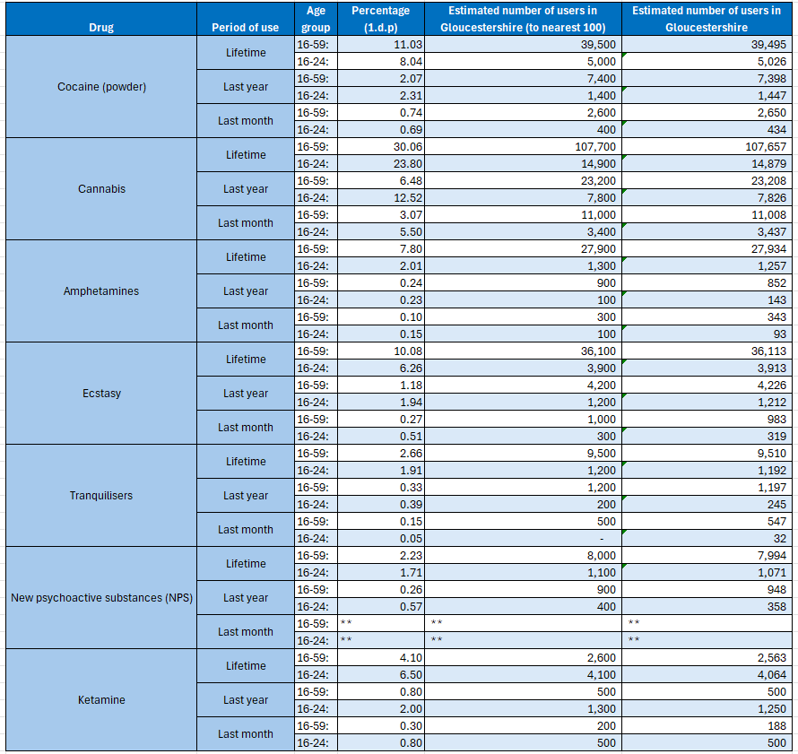
While it remains below the England average of 57. 1% and our own ambition of 50%, it is showing a steady upward trajectory of improvement thanks to the creation of fully funded dedicated posts and enhanced processes
Section 2 - National and local intelligence
Pillar 1 – Breaking drug supply chains
Key Points cont.
During 2024-2025, 288 people came through the Out of Court Disposals Scheme (for lower-level offenders and where drugs are considered to be an aggravating factor) and 44 people were referred through a Community Rehabilitation Order (mandated by court and supervised by the Probation Service).
For those individuals who receive a custodial sentence, upon release from prison there are referral routes back into community treatment - this is referred to continuity of care from prison. Gloucestershire’s continuity of care (the percentage of prison leavers with ongoing substance misuse treatment needs who commence community treatment within three weeks of leaving prison) has improved.
Table 3: Indicative (crude) estimates of the prevalence of illegal drug use within Gloucestershire, adapted from the Crime Survey for England and Wales, 2025 ²⁰
20
Drug and Alcohol
Needs Assessment

Slide 22
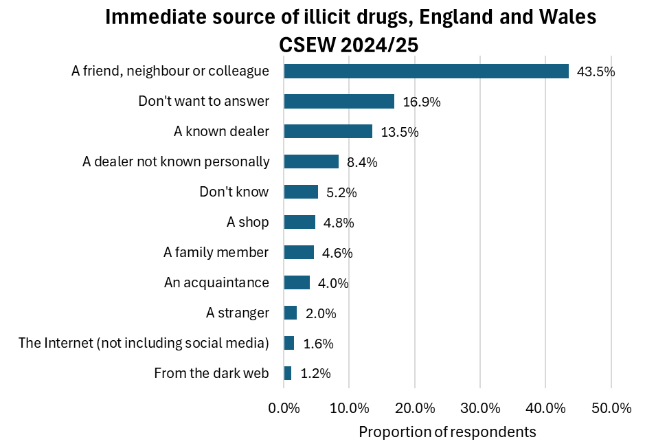
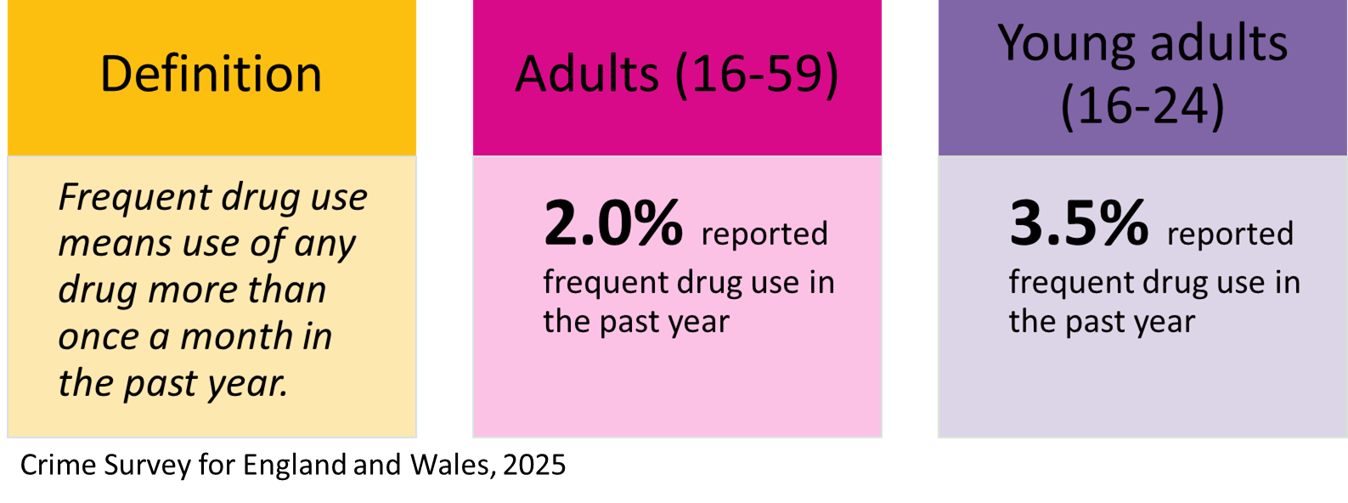
Section 2 - National and local intelligence
Pillar 1 – Breaking drug supply chains
The Crime Survey for England and Wales shows us how people obtain drugs. This is outlined in Figure 4. This shows us that just under half of respondents obtained drugs via a friend, neighbour or colleague in the last 12 months (43.5%), the next highest obtainment method was through a known dealer (13.5%).
Also, newly available to us is information about frequency of drug use amongst people living in England and Wales.
Figure 4: Immediate source of illicit drugs in the last 12 months, England and Wales. CSEW 2024/25
21
Drug and Alcohol
Needs Assessment

Slide 23
Section 2 - National and local intelligence
Priority Action | Outcome
We will give service users past and present an organisation that can provide support to them and represent their voice to the local partnership and commissioners. | Via, Nelson Trust and Emerging Futures worked together to develop opportunities for service user involvement, peer mentoring and volunteering. Actions include: Monthly service user consultation forums are in place a Super Service User Council has been established Courses delivered include Via’s NOVA (Nurturing Opportunities, Visions and Aspirations), Peer Mentor accredited Level 2 training Volunteering opportunities have been provided across the treatment and recovery system Lived Experience representative on the Combatting Drugs Partnership Gloucestershire’s first Recovery Festival held in 2025
We will prioritise recruitment and retention of the specialist workforce to reduce individual worker caseloads and increase treatment quality. We will implement a local Workforce Development Scheme (WFD). | WFD 90 Day Substance Misuse Traineeship (from May 2023) to cultivate well-rounded practitioners equipped to sustainably operate in the sector. From April 2024 to March 25 this delivered 10 successful completions, 7 of whom went into employment and 1 into a volunteer role.
We will work with prisons to create clear resettlement pathways and reduce reoffending and will continue to work with the probation service to engage prison leavers. | Ambition to achieve 50% continuity of care by the end of 2024/25 (from 24% at the end of 2021/22). The latest available information shows that this has now increased to 38.8% (2024/25).
Using Individual Placement Support (IPS) funding, we will employ a Senior Employment Specialist and 2 Employment Specialists to offer intensive employment support as part of our multi-disciplinary clinical services. Minimum 25 clients receiving pre-employment support | The Gloucestershire Employment and Skills Hub was commissioned to deliver IPS to help drug and alcohol users into employment. Performance in this area has been difficult to sustain.
Pillar 2 – Delivering a world-class treatment and recovery system
This section describes Gloucestershire’s approach to supporting people to overcome substance dependency. It outlines the services we have put in place and provides updates on our progress, including progress against priority actions identified in the previous Needs Assessment.
What have we delivered since the last Needs Assessment?
Since the last Needs Assessment in 2022, we have commissioned a new provider of drug and alcohol treatment and recovery services. Via Care Ltd partners with Nelson Trust, Emerging Futures and Young Gloucestershire to ensure we have sufficient capacity, reach and expertise to provide the services Gloucestershire needs.
Structured treatment, advice and care are provided in various locations across the county, primarily at sites in Gloucester city centre, Cheltenham, Stroud and Cinderford. Group sessions, 1:1 support, home visits, peer mentors and personal key workers form the foundation of the service which also offers safe spaces, women-only services and outreach to personalise the provision
Drug and Alcohol
Needs Assessment
22

Slide 24
We are also exceeding the ambitions we have agreed with OHID for the Opiate User cohort completing treatment (47%) but have more work to do to achieve our ambitions for people using non-opiates (30%) and alcohol (42%).
We are making good progress towards our ‘Continuity of Care’ ambition. Over the last year we have used some of our grant funding to pay for dedicated workers which is driving up performance and is narrowing the gap between Gloucestershire (38.8%) and England (57.1%).
We are working hard to make sure our treatment and recovery services are accessible to everyone. With this in mind, we commissioned community organisations to help us engage with people from minority ethnic groups so that we can better understand the needs of all our communities and to respond to them appropriately. Engagement sessions run by The Friendship Café and by The All Nations Club throughout Autumn and Winter 2025 are providing us with vital insight to what works well and what can be improved.
In 2024/25, 16.7% of the Gloucestershire treatment population had an unmet mental health need – this proportion has remained similar since the data started being recorded in 2022²³.
We have new access to data relating to hospital admissions for drug poisoning and for substance misuse. This tells us that substance misuse admissions in Gloucestershire are below the national rate for both adults and those aged between 15 and 24 years, with an overall downward trend from 2019 ²⁴.
In 2024/25, there were 35 deaths registered due to the misuse of illegal or controlled substances in Gloucestershire. This is a decrease of 25% since the previous year. Post-COVID, there has been a significant increase in the rate of alcohol-specific deaths in Gloucestershire, however, there is some evidence to suggest the rate is decreasing.
Section 2 - National and local intelligence
Pillar 2 – Delivering a world-class treatment and recovery system (Overview)
Key points:
In 2024/25, we treated 2,399 people in our adult services and 120 in our children and young people services .
Latest official estimates (DHSC) suggest that approximately 2,889 people use opiate (primarily heroin) and or crack (cocaine) in the county. This is equivalent to a rate of 7.2 per 100,000 population which is significantly lower than the England rate of 8.5 ²¹. However, these rates indicate there is still unmet need in Gloucestershire.
We record and measure the proportion of those in treatment who successfully complete their treatment, are drug-free in treatment, or have sustained reduction in drug use. Gloucestershire’s proportion of opiate, non-opiate and alcohol users retained in treatment all exceed the England average.
23
Drug and Alcohol
Needs Assessment

Slide 25
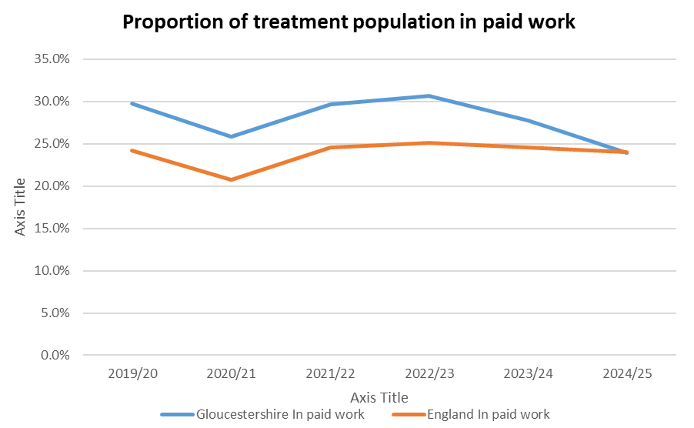
Section 2 - National and local intelligence
Pillar 2 – Delivering a world-class treatment and recovery system (Work)
Key points continued:
We know that being in employment has a significant protective factor in terms of many outcomes, including mental ill health, housing, poverty and other drivers of substance use.
However, since 2022/23 there has been a decrease in the proportion of people in treatment for drug and/or alcohol use who are in paid work in Gloucestershire.
While Individual Placement Support has been embedded in Gloucestershire County Council’s Employment Hub, recruiting and retaining specialist staff to roles which work with people experiencing dependency has been problematic. This has adversely impacted on our ability to support people into work.
24
Drug and Alcohol
Needs Assessment

Slide 26
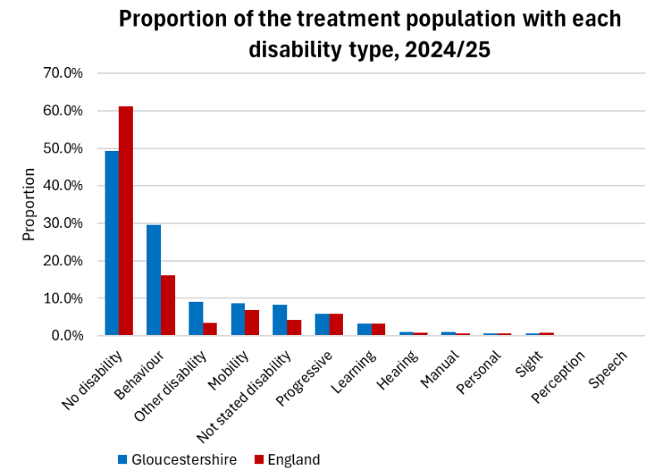
Section 2 - National and local intelligence
Pillar 2 – Delivering a world-class treatment and recovery system (Disability)
In general, Gloucestershire has a higher level of disability amongst its treatment population than England (in 2024/25 46.2 % Gloucestershire, 33.4% England). Almost a third of Gloucestershire’s treatment population stated they had a behavioural disability (29.7%) - this could either be their only disability or in combination with another disability.
25
Drug and Alcohol
Needs Assessment

Slide 27
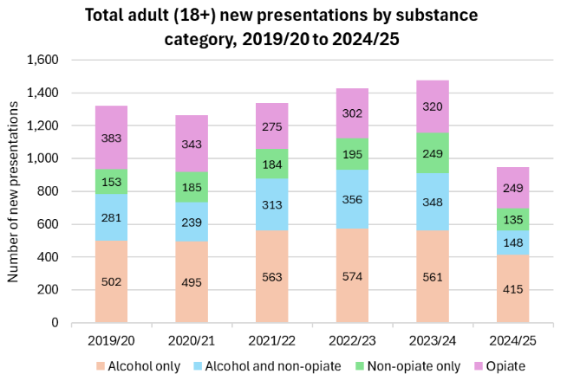
Section 2 - National and local intelligence
Pillar 2 – Delivering a world-class treatment and recovery system (New presentations)
This chart shows the number of people who newly access substance use treatment since 2019, together with the primary substance they are using. Noting that the data collection methodology changed at the start of 2024/25, we can see an overall rising number of people in treatment while the substances of choice have remained broadly similar.
26
Drug and Alcohol
Needs Assessment

Slide 28
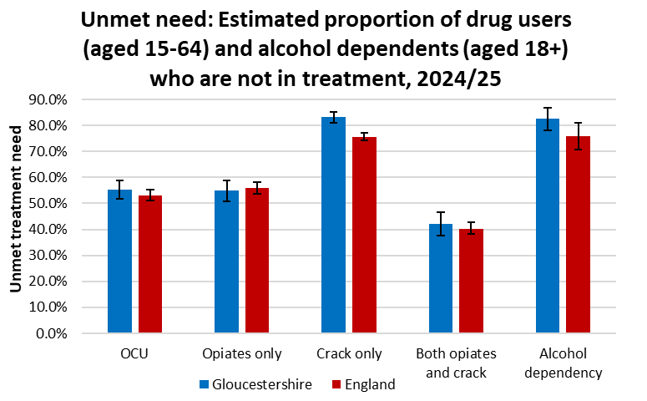
Section 2 - National and local intelligence
Pillar 2 – Delivering a world-class treatment and recovery system
The data presented below brings together intelligence that is newly available for this refreshed Needs Assessment and data that we have used in previous analyses. Taken together, it provides insight into where our service users are, who they are and what they need.
Figure 5: Unmet need: Estimated proportion of drug users (age 15-64) and alcohol dependents (aged 18+) who are not in treatment, 2024/25²⁵
It is important to note that this data only provides an indication of unmet need and is based on 2022/23 estimated prevalence data for drug use and 2019/20 data for alcohol dependency.
There has been no significant change in unmet need over time. The data indicates that in the year 2024/25, 57 .3% of opiate and crack users were not engaged in treatment. In 2024/25, however, there was an unmet need of 82.6% for Gloucestershire adults with alcohol dependency which is higher than the national average. There has been no significant change in this rate between 2015/15 and 2019/20.
26
Drug and Alcohol
Needs Assessment

Slide 29
As is typically the case in a rural county though, we can see that there are challenges in meeting the needs of people who live outside the more urban areas.
Section 2 - National and local intelligence
Table 4: Drug and Alcohol Treatment Population broken down by Gloucestershire district, 2024-25²⁶
District | Alcohol |  | Alcohol and Non-Opiate |  | Non-Opiate |  | Opiate
 | Count | Proportion of total | Count | Proportion of total | Count | Proportion of total | Count | Proportion of total
Cheltenham | 110 | 16.4% | 53 | 17.5% | 30 | 13.2% | 231 | 19.0%
Cotswold | 76 | 11.3% | 18 | 6.0% | 13 | 5.7% | 76 | 6.3%
Forest of Dean | 57 | 8.5% | 33 | 10.9% | 35 | 15.4% | 177 | 14.6%
Gloucester | 200 | 29.8% | 95 | 31.5% | 87 | 38.2% | 396 | 32.6%
Stroud | 143 | 21.3% | 62 | 20.5% | 41 | 18.0% | 188 | 15.5%
Tewkesbury | 71 | 10.6% | 30 | 9.9% | 11 | 4.8% | 110 | 9.0%
No Fixed Address | 9 | 1.3% | 4 | 1.3% | 9 | 3.9% | 25 | 2.1%
Unknown | 6 | 0.9% | 7 | 2.3% | 2 | 0.9% | 13 | 1.1%
Total | 672 | 100.0% | 302 | 100.0% | 228 | 100.0% | 1216 | 100.0%
Pillar 2 – Delivering a world-class treatment and recovery system (Access to treatment)
The maps below show the home location of our treatment population, by Lower Super Output Area and by substance . Individually and collectively, they show us that our service users predominate in the more urban areas of the county, but that significant need exists beyond our towns and city. This is particularly the case for alcohol use. We can see that the primary bases of our treatment providers (in Gloucester city centre, Cheltenham, Stroud and Cinderford) and regular outreach clinics (in Tewkesbury, Winchcombe, Moreton in Marsh and Cirencester) align well with the locations of the treatment population.
^{[i]} Gloucestershire VIA. Drug and Alcohol Treatment Population broken down by Gloucestershire district, 2024-25.
28
Drug and Alcohol
Needs Assessment

Slide 30
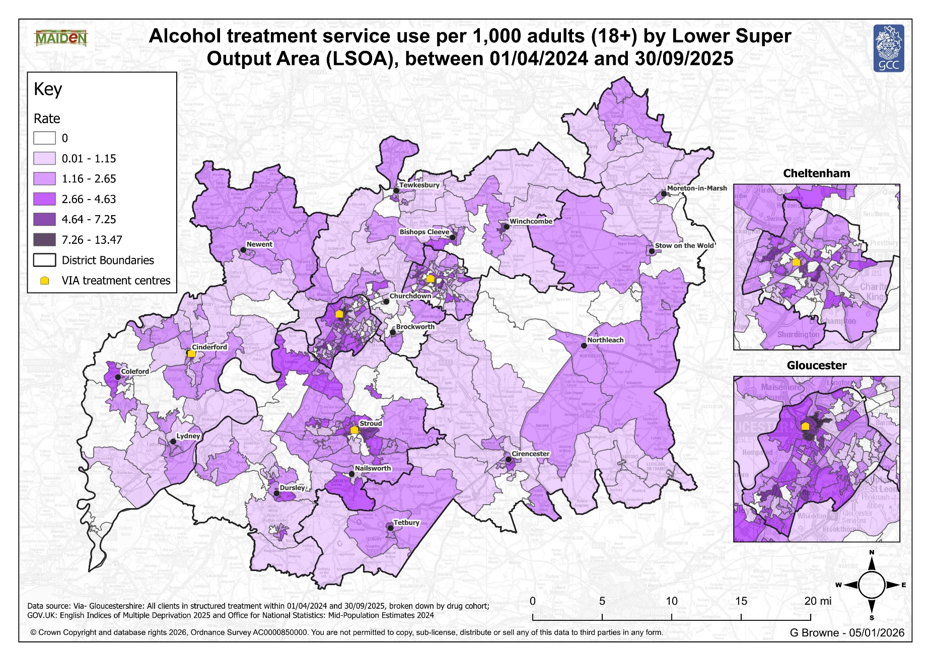
Figure 6: Alcohol treatment service use per 1,000 adults (18+) by Lower Super Output Area (LSOA), between 01/04/2024 and 30/09/2025

Slide 31
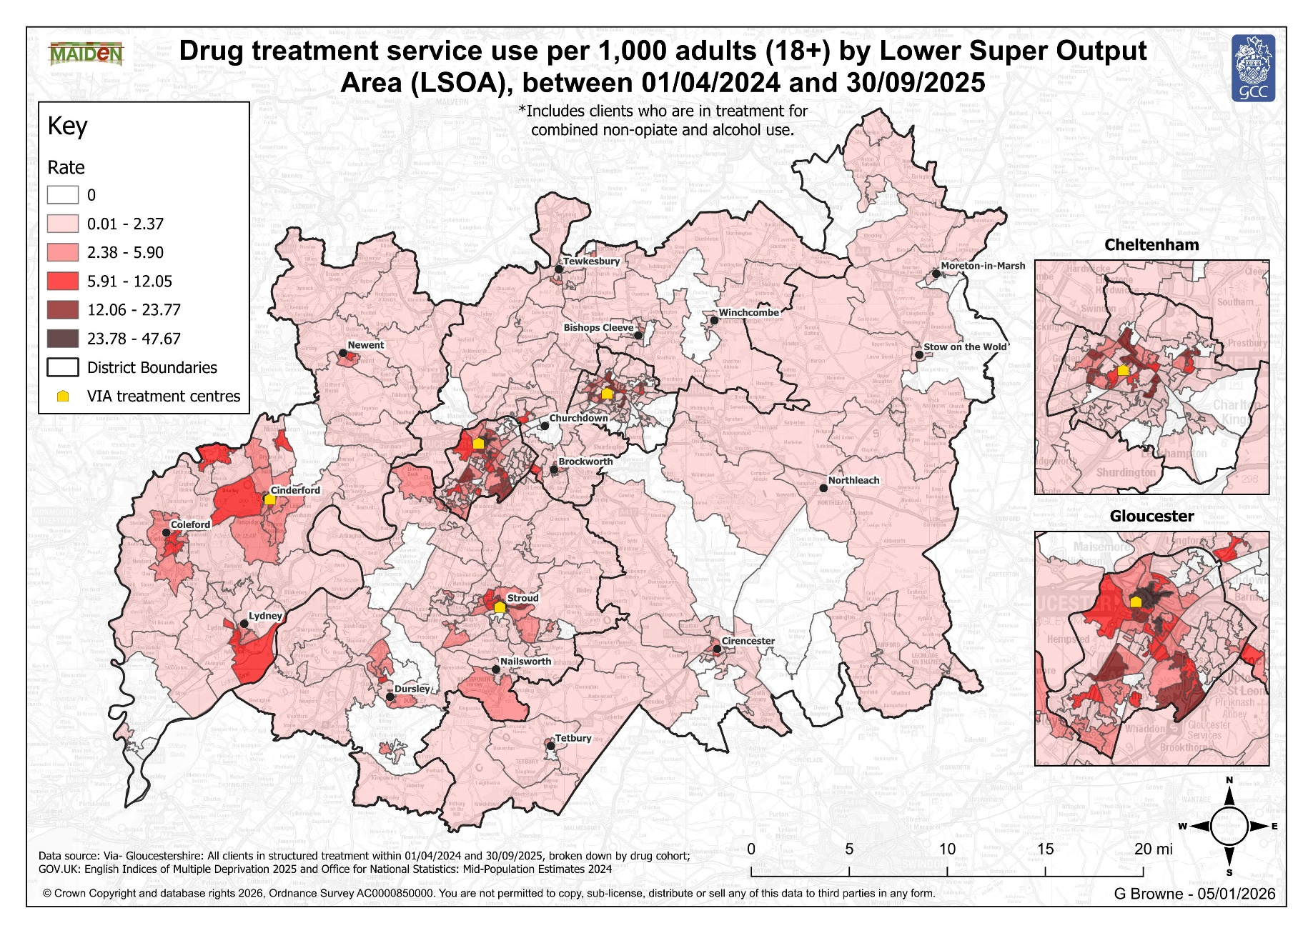
Figure 7: Drug treatment service use per 1,000 adults (18+) by Lower Super Output Area (LSOA), between 01/04/2024 and 30/09/2025

Slide 32
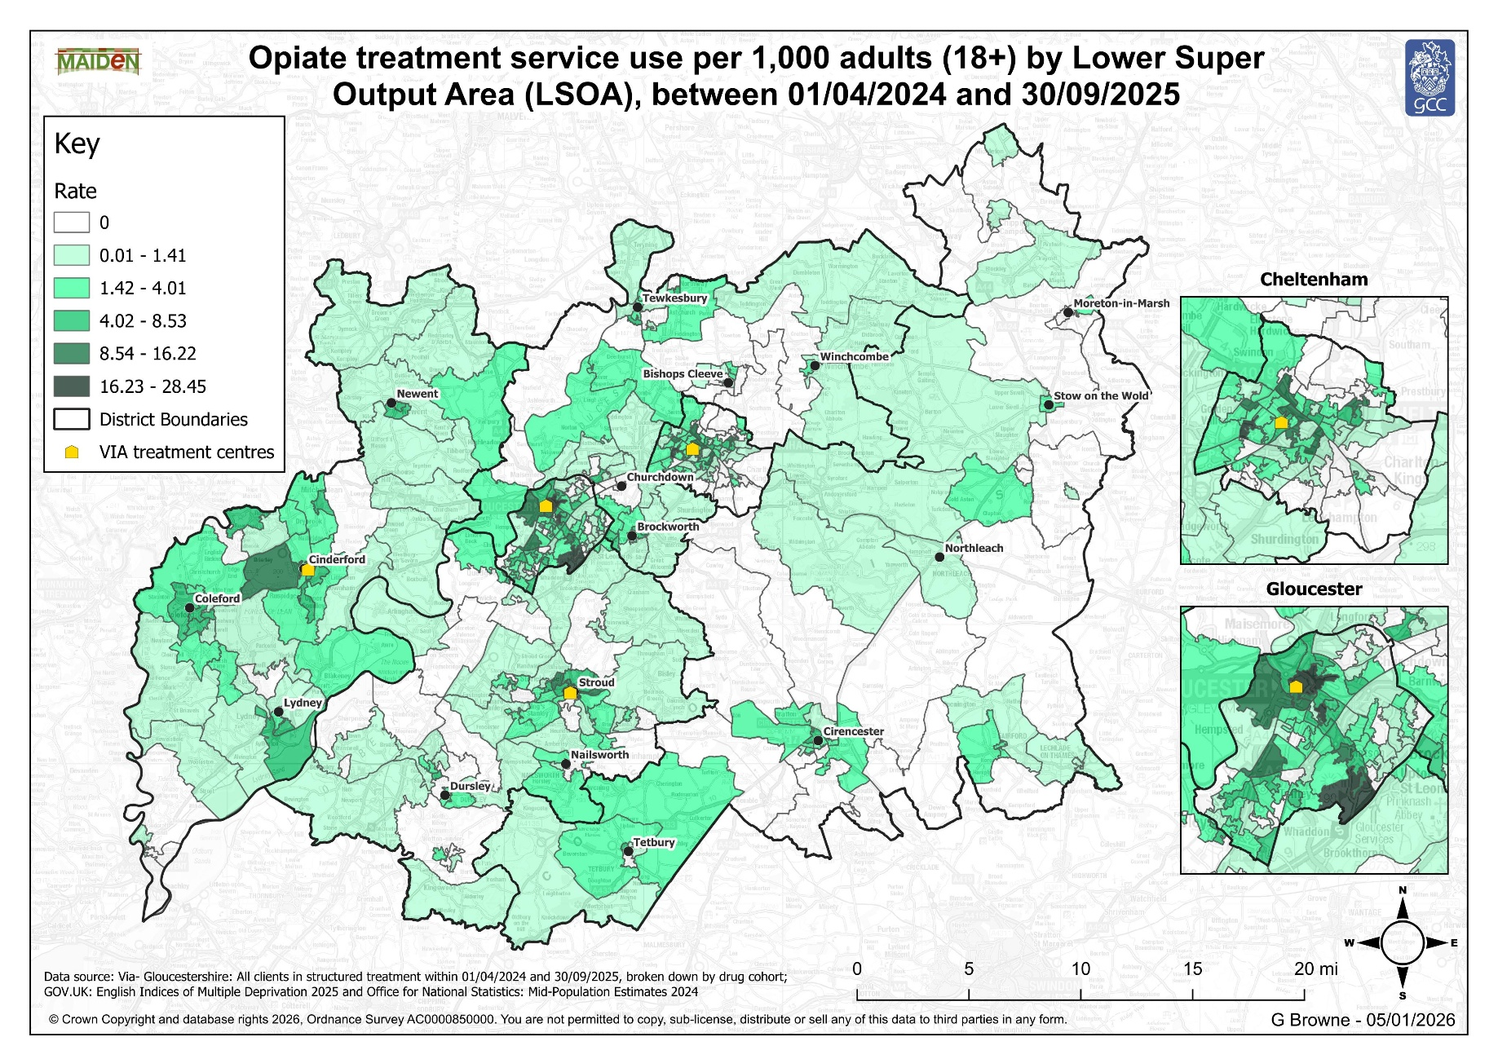
Figure 8: Opiate treatment service use per 1,000 adults (18+) by Lower Super Output Area (LSOA), between 01/04/2024 and 30/09/2025

Slide 33
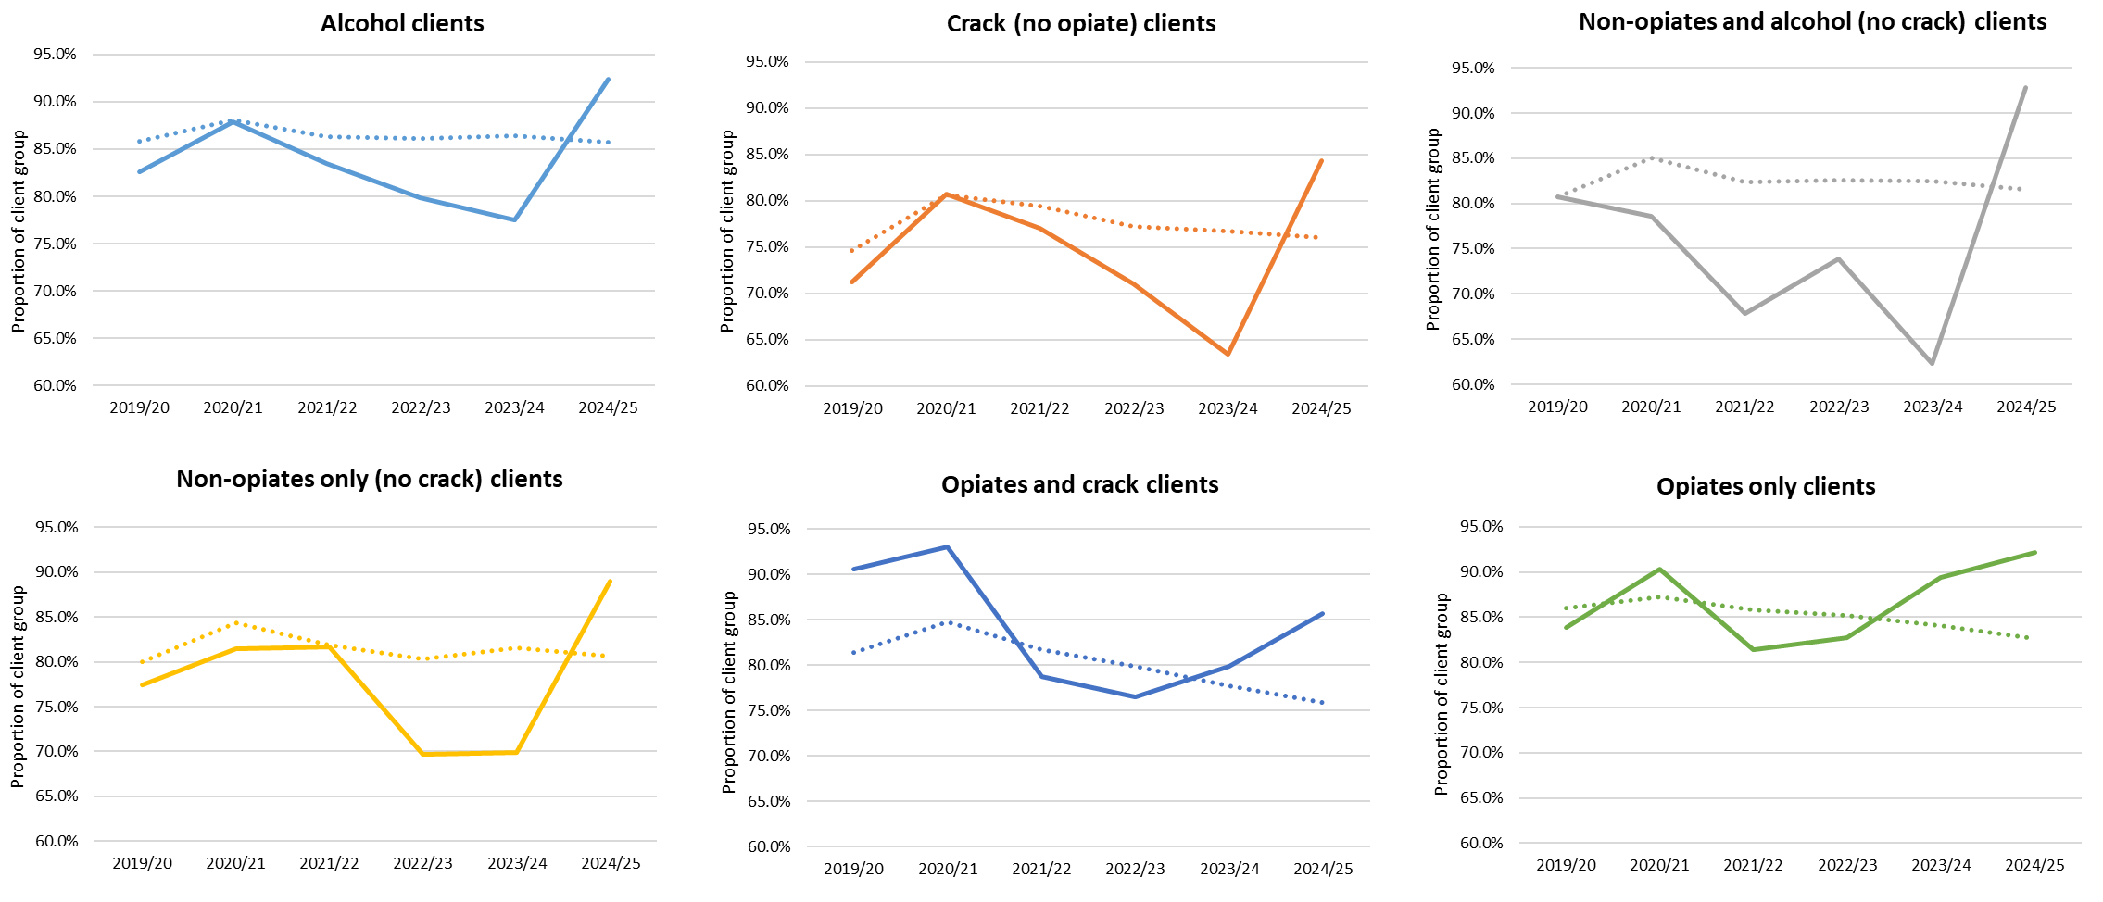
Section 2 - National and local intelligence
Pillar 2 – Delivering a world-class treatment and recovery system (Sustaining treatment)
The charts below show Gloucestershire’s track record of how many people who access treatment remain in treatment at 12 weeks (Source: NDTMS). This is important to understand as it shows how well our provision maintains engagement with users, which in turn increases the likelihood of successful completion of treatment and recovery. Gloucestershire’s performance considerably exceeds the national average for opiate, non-opiate and alcohol users.
Figure 9: Proportion of clients (by substance type) retained for 12 weeks following treatment start (including. successful completions and planned exits in that period)²⁷ (England comparison shown by the dotted lines)
32
Drug and Alcohol
Needs Assessment

Slide 34
Section 2 - National and local intelligence
The reasons behind this are complex but can include a reluctance on the part of users to seek early support, misattributing symptoms to substance use and a reduced likelihood of adhering to healthy behaviours such as taking medication, eating a healthy diet or taking regular exercise. Substance use is also often linked to higher rates of unemployment, unstable housing, deprivation, smoking tobacco, all of which are themselves linked to poor health outcomes²⁸.
It is also important to note that, according to Dame Carol Black’s national review, people can be excluded from mental health services until they resolve their drug problems, while also being excluded from substance use services until their mental health problems are being addressed. In December 2025, the government published the Co-occurring Mental Health and Substance Use Delivery Framework²⁹ which sets out a programme of work to improve the quality and integration of service provision for people with both mental health and substance use needs.
We will need to consider how the Gloucestershire system responds to this new framework and its four priorities of Strategic Leadership and service model design; Data and monitoring; Workforce and training; and Commissioning and incentives.
Pillar 2 – Delivering a world-class treatment and recovery system (Health)
Physical and mental health needs of the treatment population
People with a history of substance use often have poor physical and mental health and have worse outcomes (including higher risk of death) from a range of health conditions compared to those who have the condition but no history of using drugs and/or alcohol.
33
Drug and Alcohol
Needs Assessment

Slide 35
Section 2 - National and local intelligence
and by commissioning Via initiatives such as needle exchange (to reduce incidence of HIV and Hepatitis C), opioid substitution and using key workers to support users to access appropriate health services.
Even with these and other interventions in place, we know that our treatment population is at risk of experiencing poor physical and mental health. A review of service user deaths across 2024-25 indicates a high prevalence significant physical health comorbidity within the treatment population, with many suffering with cardiovascular and respiratory disease alongside their drug and/or alcohol dependence.
This is an ageing population carrying chronic health conditions with the mortality caused by underlying health being concentrated in those 35 years of age and older. In many cases the health conditions implicated in the cause of death were not known before highlighting an unmet need. Opioid-related deaths make up the largest proportion of drug-related deaths across the UK, with an average of 40 deaths a week.
Gloucestershire’s population of opiate users has been using drugs dependently for more than two decades (on average) - they are ageing and that they will be at particular risk of poor outcomes, including frailty and premature death. Deaths within this cohort give a picture of a population highly susceptible to lung problems including, chronic obstructive pulmonary disease (COPD) limiting mobility and leaving them susceptible to pneumonia as well as fatal diseases linked to injecting behaviour such as endocarditis.
Pillar 2 – Delivering a world-class treatment and recovery system (Health)
Physical and mental health needs of the treatment population
We dedicate some of our funding to supporting specialist interventions for people who are at greater risk to their health. This includes funding Gloucestershire Hospitals NHS Trust to provide specialist midwifery, Blood Borne Virus and alcohol liaison posts, funding Gloucestershire Health and Care NHS Foundation Trust to provide ‘co-occurring conditions’ capacity (which aims to connect mental health services with substance use services)
34
Drug and Alcohol
Needs Assessment

Slide 36
Mental health need: The latest statistics available
Mental health need
Unmet mental health need
Unmet mental health need by substance group
75.7%
of people entering treatment had a mental health need in 2024/25
16.7%
of treatment population had an unmet health need in 2024/25
Admissions to hospital for alcohol attributed MH
Sex differences in admissions to hospital for alcohol attributed MH
Admissions to hospital for drug-related mental and behavioural disorders
Rate per 100,000 population
Rate per 100,000 population
Rate per 100,000 population
Data source: NDTMS and OHID Fingertips

Slide 37
In Gloucestershire in 2024/25, 88.9% (1,964)³² of the adult treatment population had a mental health treatment need. In the same year, 16.7% of the Gloucestershire treatment population (328 people) had an unmet mental health need – this proportion has remained similar since the data started being recorded in 2022 and is broadly in-line with rates in the rest of England³³.
Unmet Mental Health need was highest in the non-opiate treatment groups. Also, in males and 18-29 year olds³⁴.
Around 10.0% of young people in treatment have a mental health need, and a very small proportion have an unmet mental health need.
In 2023/24, there were 35.4 admissions per 100,000 population to hospital where the primary diagnosis is an alcohol attributable mental and behavioural disorders, this rate is significantly lower than the England rate and there has been a decreasing trend since 2020/21³⁵.
In 2023/24, there were 4.2 hospital admissions with a primary diagnosis of drug-related mental and behavioural disorders, per 100,000 population. This rate is also significantly lower than the England rate and there has been a decreasing trend since 2020/21³⁶.
Almost a third of Gloucestershire’s treatment population tells us that they have a behavioural disability (29.7%), and 1 in 2 clients have a physical or mental disability³⁷.
Hospital admissions for poisoning by drug misuse have fallen considerably over recent years from a high of 194 in 2015/16 to a low of 51 in 2022/23. While there was a small increase in numbers admitted in 2023/24, the overall trend remains downward³⁸.
Gloucestershire has below national average admission rates for substance misuse overall, including for young people, but has slightly higher rates for alcohol-related admissions.
Section 2 - National and local intelligence
Pillar 2 – Delivering a world-class treatment and recovery system (Health)
Physical and mental health needs of the treatment population - Key points
Nationally, almost three-quarters of adults starting treatment for drug and/or alcohol dependency say they have a mental health treatment need. Over a third of people with serious mental illness have co-existing drug or alcohol conditions, associated with poor health and social care outcomes [Harris and others, 2023]³⁰. Over one-fifth of people in England who had a mental health need were not receiving any treatment to meet this need³¹.
36
Drug and Alcohol
Needs Assessment

Slide 38
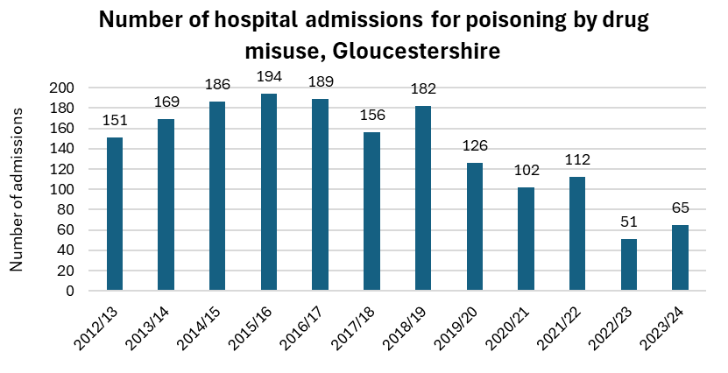
We know that people who are experiencing homelessness and using substances are particularly vulnerable in terms of their mental and physical health. For this reason, Via recovery practitioners are deployed in the Complex Homeless Partnership Support Service (CHPSS) which provides proactive outreach in Gloucester and Cheltenham (where there are the greatest numbers of rough sleepers³⁹) . The multi-agency CHPSS team provides wraparound support to ensure mental health, housing and substance use needs are addressed in a co-ordinated way. There are currently 27 Via clients accessing this support which represents a slight increase, reflecting a growing understanding of the needs of this vulnerable group.
Between 2022/23 and 2024/25, there has been an increase in the number of people entering treatment who are rough sleeping, from 16 in 2022/23 to 36 in 2024/25. From 2026, we will have new access to grant funding to support working with this cohort.
Section 2 - National and local intelligence
Pillar 2 – Delivering a world-class treatment and recovery system (Health)
In 2024, there were 35 deaths registered due to drug poisoning in Gloucestershire, this is a decrease compared to 2023 when the highest number of deaths was recorded in any year except from 2020. There were 16 fewer deaths registered in 2024 compared to 2023, a decrease of 31.4%. Since 2014-2016, there has been a statistically significantly higher rate of age-standardised male deaths due to drug misuse than female deaths. Most of the deaths were in people who are undergoing treatment for opiate use (25/36 deaths).
Figure 10: Number of hospital admissions for poisoning by drug misuse, Gloucestershire
37
Drug and Alcohol
Needs Assessment

Slide 39
Section 2 - National and local intelligence
In 2023/24, there were 65 admissions to Gloucestershire hospitals where the primary diagnosis was drug misuse. This is 14 more admissions than in 2022/23, however, both 2022/23 and 2023/24 saw the lowest number of admissions compared to all other years shown on the graph.
Pillar 2 – Delivering a world-class treatment and recovery system (Health)
Hospital admissions for drug and alcohol- 2023-24 | Gloucestershire rate (per 100,000) | England rate (per 100,000)
Hospital admissions for poisoning by drug misuse | 9.6 | 17.5
Hospital admissions for substance misuse (15-24ya) (2021/22 to 2023/24) | 33.4 | 47.4
Admission episodes for alcohol-related conditions (broad) | 1,306 | 1,824
Admission episodes for alcohol-related conditions (narrow) | 423 | 504
Table 5: Hospital admissions for drug and alcohol misuse⁴⁰
Figure 10: Number of hospital admissions for poisoning by drug misuse, Gloucestershire
38
Drug and Alcohol
Needs Assessment

Slide 40
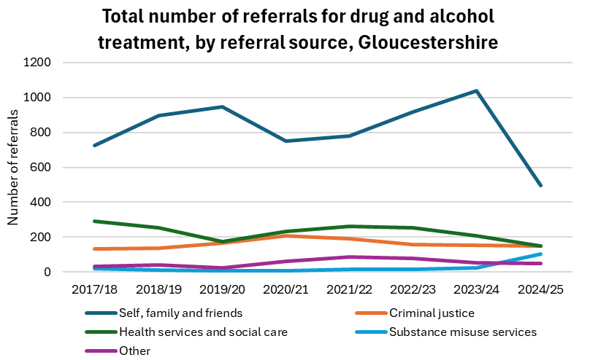
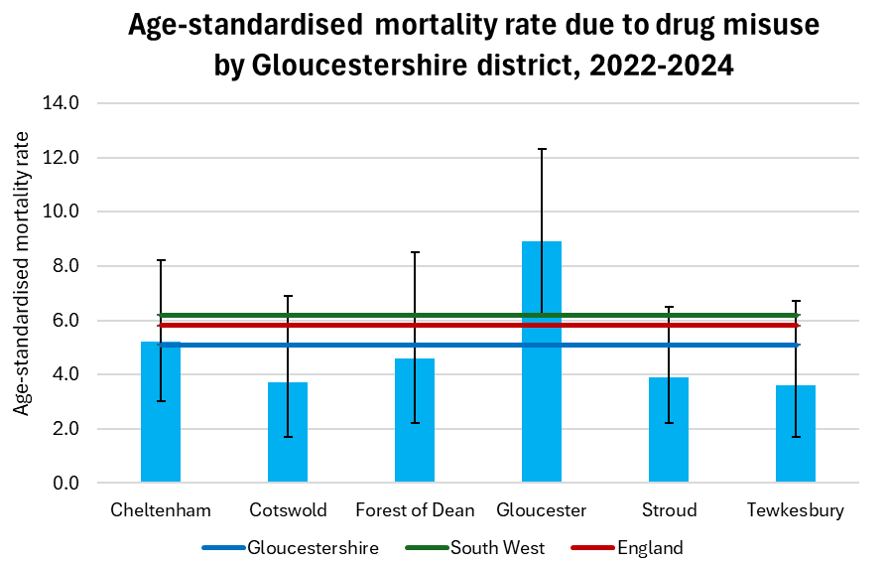
In 2022-2024, Gloucester had the highest age-standardised mortality rate due to drug misuse (8.9 deaths per 100,000) and Tewkesbury had the lowest rate (3.6 deaths per 100,000), compared to the other districts. However, there was no statistically significant differences between any of the districts or when compared to Gloucestershire, the South-West or England.
Referrals by family and friends make up the largest proportion of referrals made to the treatment service, accounting for 52.5% in 2024/25. Over the same time period, 15.6% of adult treatment referrals were by health services and care, this is lower than the England proportion of 20.9 %.
Section 2 - National and local intelligence
Pillar 2 – Delivering a world-class treatment and recovery system (Health)
Figure 11: Age-standardised mortality rate due to drug misuse by Gloucestershire district, 2022-2024
Figure 12: Total number of referrals for drug and alcohol treatment, by referral source, Gloucestershire⁴¹
39
Drug and Alcohol
Needs Assessment

Slide 41
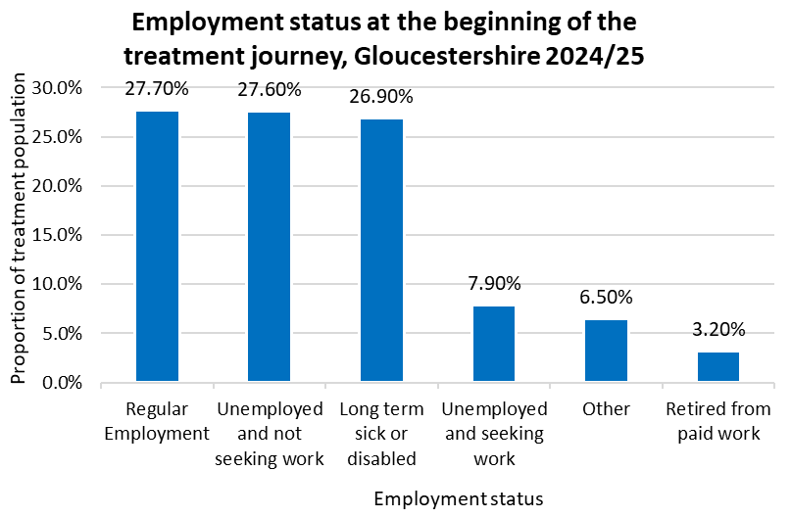
Section 2 - National and local intelligence
Pillar 2 – Delivering a world-class treatment and recovery system (Employment)
Figure 13: Employment status at the beginning of the treatment journey, Gloucestershire 2024/25
In 2024/25, the majority of Gloucestershire’s treatment population were not in employment with 23.9% in paid work – this is in line with the England average. Since 2022/23, there has been a decrease in the proportion of people in treatment who are in paid work.
The graph below shows the breakdown of employment status for people entering treatment in 2024/25, over a quarter of the population accounted for each of the categories: regular employment, unemployed and not seeking work and long-term sick or disabled.
Unemployment is associated with an increased risk of ill health and mortality. There are also relationships between unemployment and poor mental health and suicide, higher self-reported ill health and a higher prevalence of risky health behaviours such as smoking and alcohol use. For this reason, the Black Review ⁴² made recommendations aimed at increasing the number of people able to move from treatment to paid employment. Since 2024, Gloucestershire has received Individual Placement Support (IPS) funding to support this aim.
40
Drug and Alcohol
Needs Assessment

Slide 42
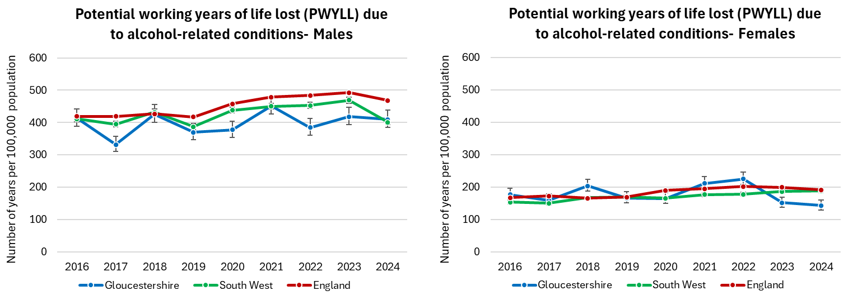
Gloucestershire performs better than the England average for potential working years of life lost (PWYLL) due to alcohol-related conditions per 100,000 population. Across all areas, males experience a significantly higher PWYLL rate compared to females.
Section 2 - National and local intelligence
Pillar 2 – Delivering a world-class treatment and recovery system (Employment)
IPS is a specialist intervention to help people find and stay in work. It offers intensive, individually tailored support to help people to choose and find the right job, with ongoing support for the employer and employee to help ensure the person keeps their job. In Gloucestershire, it is delivered by the County Council’s Employment & Skills Hub, but strong performance has been difficult to establish because of issues relating to the recruitment and retention of suitably skilled and experienced staff.
Potential working years of life lost (PWYLL) due to alcohol-related conditions- Males and Females
Figure 14: Potential working years of life lost (PWYLL) due to alcohol-related conditions- Males and Females ⁴³
41
Drug and Alcohol
Needs Assessment

Slide 43
Section 2 - National and local intelligence
Growing up in a household with adults experiencing alcohol and drug use problems is an adverse childhood experience in itself. Individuals who experience Adverse Childhood Experiences (ACEs) are at an increased risk of exposing their own children to ACEs, which can create an intergenerational cycle of substance misuse (source: World Health Organization).
In Gloucestershire, the Pupil Wellbeing Survey (2024)⁴⁵ found that around 1 in 10 children in Years 10 and 12 reported that they had 4 or more ACEs. Children with one parent who misuses alcohol are 2.5 times more likely to also misuse alcohol than those whose parents do not misuse alcohol (source: Public Health England ).
Pillar 2 – Delivering a world-class treatment and recovery system (Children & Young People)
Gloucestershire’s Young People’s Substance Misuse Treatment Service is part of our commissioned Youth Support service, and treatment includes psychosocial interventions delivered by a multi-professional health team following NICE clinical guidance.
Experience of one or more childhood adversities has been linked to poorer physical and mental health outcomes in adolescence and adulthood. Individuals who experience multiple adversities in childhood are more likely to abuse drugs and alcohol. A study conducted in 2014 in England found that adults who had experienced four or more adversities in their childhood were twice as likely to binge drink and eleven times more likely to go on to use crack cocaine or heroin ⁴⁴.
42
Drug and Alcohol
Needs Assessment

Slide 44
Section 2 - National and local intelligence
We know that 12.8% of our adult treatment population live in a household with children under 16 (single person with child(ren) 7%; persons with child(ren) under 16 5.8%)
Just over half of children and young people (57.6%) entering treatment in 2024/25 were in mainstream education which is similar to England (61%). 15.2% were in alternative education, 12.1% classed as NEET (Not in Education, Employment or Training), 10.6% were employed.
Between 2020/21 and 2024/25, there has been a notable increase in the proportion of the treatment entrant population who are in mainstream education compared to previous years. In the same period, there has been a decreasing trend in the proportion who are in alternative education or classified as a NEET.
NDTMS data indicates that 901 clients (37.6%) in the adult treatment population are parents and 530 (58.5%) are living with their children. There were also 11 young people in treatment who were living in ‘secure care’.
Pillar 2 – Delivering a world-class treatment and recovery system (Children & Young People)
Key points
Broadly speaking, the number of young people (aged under 18 years) in treatment has been rising, from 57 in 2019/20 to 120 in 2024/25. Latest information suggests this trend is levelling off and while the number remains a small proportion of our overall treatment population, this is a group of people which we actively wish to engage with early and preventatively.
Like the adult treatment population, the majority of young people receiving treatment are male (65.8% male: 34.2% female in 2024/25).
Referrals for young people into the service predominantly come from education services (33.3%) or children and family services (30.3%).
43
Drug and Alcohol
Needs Assessment

Slide 45
NDTMS: National Drug Treatment Monitoring System 2024/25- Gloucestershire young people aged 17 and under
66 new clients
120 young people in treatment
68 treatment exits
5 (7%)
incomplete
63 (93%)
completed
0 (0%)
transferred
Source of referral to treatment
Sex split
Age distribution
33%
made by education services
30%
made by children and family services
34.2%
65.8%
Male
Female
Substance use
95%
YP cited problem cannabis use
Ethnicity
Education status
1 in 10
young people were from a minority ethnic background*
57.6%
entering treatment were in
mainstream education
Data source: NDTMS *where the characteristic is known

Slide 46
Section 2 - National and local intelligence
Tertiary services which provide treatment, mitigate harm and promote recovery are provided by our commissioned provider partners: Via, Nelson Trust, Emerging Futures and Young Gloucestershire . This includes structured treatment, onward referrals to specialist services and access to detox and rehab options.
Pillar 3 – Achieving a shift in the demand for recreational drugs
What have we delivered since the last Needs Assessment?
Priority Action | Outcome
Develop a co-ordinated communications plan for schools through education channels to help schools navigate what primary and preventative resources are available for them. | Mapping completed
Undertake an assessment to better understand the level of need in relation to Tier 2 drug and alcohol interventions and the current provision of Tier 2 support. | Young people specialist providers undertook a review to identify need and support. These reports are completed and will form the basis of any future commissioning when OHID outline any potential future funding in this area.
This section sets out our Gloucestershire approach to prevention. It outlines progress made since the last Needs Assessment and suggests opportunities for improvement.
Primary prevention (stopping people from starting substance use) is largely delivered through work with schools provided by Gloucestershire Healthy Living and Learning (GHLL) and through education and awareness-raising led by Young Gloucestershire, our Youth Support Service and Via.
We also deliver secondary prevention (early intervention and work to reduce the harms that people do to themselves and others whilst they are using drugs and alcohol) through initiatives such as providing naloxone kits to reduce fatal overdoses and needle exchange to prevent the spread of blood borne viruses.
45
Drug and Alcohol
Needs Assessment

Slide 47
Section 2 - National and local intelligence
  In 2024/25, 9% of all clients were administered naloxone to reverse the effects of overdose (higher than the England proportion of 5%), and 16% of opiate user clients were administered naloxone (higher than the England proportion of 11%).
  Tertiary prevention: In 2024-25, 24 people went into residential rehab (of these, 67% successful completed their placement).
Data indicates there could be an increasing trend in the number of people for whom ketamine is a problem substance. In combination with soft intelligence gained through speaking with users and partners, as well as with colleagues across the south-west region, this has prompted us to take early action. While numbers in treatment are currently low (at 63 adults in 2024/25), the fact that 70% of the people receiving treatment are aged between 18 and 34 is of particular concern. Latest NDTMS data also demonstrates that ketamine use among young people has increased. We have established a Ketamine Task & Finish Group to address these concerns and to enable a swift, preventative response which is described in the case study below.
We know that most referrals for adults into treatment come from friends and family . This may indicate a need to improve awareness of the services available and their relevant referral routes for frontline professionals.
We know that the people most likely to become users are students (2.6%), private renters (1.5%), those with a household income of £20,000 - £31,200 and the children of users.
Pillar 3 – Achieving a shift in the demand for recreational drugs
Key points
Overall, there is a lack of data to definitively demonstrate and quantify the impact of early intervention and prevention both nationally and locally.
The data does include indications of positive impacts though, such as:
  Primary prevention: the vast majority or primary interventions are delivered to schools and young people, including PSHE (Personal, Social, Health and Economic education) a curriculum subject delivered in Gloucestershire schools which aims to help students to develop the knowledge, skills and attributes to stay healthy and safe.
  Secondary prevention: In 2024/25, 43% of all clients were in possession of naloxone kits (higher than the England proportion of 38%), and 80% of opiate user clients (equivalent to England).
46
Drug and Alcohol
Needs Assessment

Slide 48
Section 2 - National and local intelligence
An evolving action plan is in place which encompasses prevention, early identification and early intervention, targeted communication, specialist treatment pathways, and pathways between treatment and general health, criminal justice, and education. E.G.
A key target for early identification and intervention is the professional groups working with populations most likely to be using ketamine; a series of webinars is planned for spring 2026 which will raise awareness amongst people working within education settings, health and criminal justice. Primary Care and GPs are pivotal in identifying ketamine related harm, particularly in identifying ketamine induced uropathy, early engagement with GPs and ICB has yielded significant interest and enthusiasm as well as identifying multiple routes to raise awareness.
Pillar 3 – Achieving a shift in the demand for recreational drugs (Ketamine)
Case Study: Responding to Intelligence - Ketamine Task and Finish Group
In response to the rising local trend in ketamine use, in the summer of 2025 Gloucestershire Combatting Drugs Partnership (CDP) convened a multi-agency task and finish group to limit ketamine related harm in the County. Informed soft and hard intelligence from our county and region, and led by Public Health, the group brings together partners from across the system including: young people’s and adult services, mental health, general health and police; with links to education via the CDP Children and Young People’s working group. This group is currently building the local intelligence picture within the County, working to identify target populations and ketamine use hotspots.
47
Drug and Alcohol
Needs Assessment

Slide 49
Section 2 - National and local intelligence
The survey asked three core questions…
Pillar 3 – Achieving a shift in the demand for recreational drugs (Learning from Partners)
What are we currently doing well to tackle drug and/or alcohol related harm in Gloucestershire?
1
In Autumn 2025, the Drug and Alcohol Services Survey was distributed to stakeholders across Gloucestershire who work with individuals affected by substance use. The purpose of the survey was to gather insights on current strengths, identify gaps and challenges, and collect recommendations for improving outcomes for people and communities impacted by drug and alcohol-related harm.
What are the problems, gaps and challenges in tackling drug and/or alcohol related harm in Gloucestershire?
2
Do you have any recommendations for improving the lives of people and communities affected by substance use in Gloucestershire?
3
48
Drug and Alcohol
Needs Assessment

Slide 50
Section 2 - National and local intelligence
"Great work from younger persons substance misuse services with teaching and raising awareness of various substances being used .“
Pillar 3 – Achieving a shift in the demand for recreational drugs (Learning from partners)
Survey responses were analysed using Thematic Analysis , which identified three predominant themes for each of the survey’s core questions. These are detailed below:
What are we currently doing well to tackle drug and/or alcohol related harm in Gloucestershire?
Theme 1: Youth work
Stakeholders identified youth-focused interventions as an area of strength. Respondents noted that early intervention services, targeted youth outreach, and preventative education programmes are helping to build trusting relationships with young people and reduce the risk of harmful substance use.
"YPSMS providing bespoke packages to YP with substance misuse."
49
Drug and Alcohol
Needs Assessment

Slide 51
Section 2 - National and local intelligence
"…bringing together key partners to tackle key issues."
Pillar 3 – Achieving a shift in the demand for recreational drugs (Learning from partners)
What are we currently doing well to tackle drug and/or alcohol related harm in Gloucestershire?
Theme 2: Partnership working
Collaboration between agencies was highlighted as a strong feature of the local system. Stakeholders recognised good communication, shared problem solving, and positive relationships across services involved in prevention, treatment, and community support.
“The prison to community resource is invaluable.”
50
Drug and Alcohol
Needs Assessment

Slide 52
Section 2 - National and local intelligence
“Providing safe equipment for those actively using.”
Pillar 3 – Achieving a shift in the demand for recreational drugs (Learning from partners)
What are we currently doing well to tackle drug and/or alcohol related harm in Gloucestershire?
Theme 3: Harm reduction initiatives
Harm reduction approaches were praised for reducing the risks associated with substance use. Examples included needle and syringe programmes and crisis response services.
“Good responses to drug risk alerts.”
51
Drug and Alcohol
Needs Assessment

Slide 53
Section 2 - National and local intelligence
"Not enough joined up working between substance misuse and mental health services."
Pillar 3 – Achieving a shift in the demand for recreational drugs (Learning from partners)
"Fragmented provision of support."
What are the problems, gaps and challenges in tackling drug and/or alcohol related harm in Gloucestershire?
Theme 1: Joined up working
Although partnership working was recognised as a strength, many respondents emphasised inconsistencies in how services connect and share information. Stakeholders noted that people can experience fragmented pathways and they recognised that silo working is detrimental to service users’ progress.
"Silo working."
52
Drug and Alcohol
Needs Assessment

Slide 54
Section 2 - National and local intelligence
“Need for 1:1 work and motivational interviewing for people with complex needs.”
Pillar 3 – Achieving a shift in the demand for recreational drugs (Learning from partners)
“Drug / alcohol services close cases of non-engagement very quickly.”
What are the problems, gaps and challenges in tackling drug and/or alcohol related harm in Gloucestershire?
Theme 2: Complex needs and support limitations
Stakeholders highlighted significant challenges supporting individuals with overlapping vulnerabilities such as homelessness, mental ill health, and trauma. Respondents reported that existing services do not always have the capacity, flexibility, or specialist expertise to address these intersecting needs.
"People with complex needs don't have anywhere to go."
53
Drug and Alcohol
Needs Assessment

Slide 55
Section 2 - National and local intelligence
“Lack of access to Mental Health Services [for individuals with substance use support needs].”
Pillar 3 – Achieving a shift in the demand for recreational drugs (Learning from partners)
“Very little understanding of mental health and dual diagnosis.”
What are the problems, gaps and challenges in tackling drug and/or alcohol related harm in Gloucestershire?
Theme 3: Dual diagnosis
Dual diagnosis emerged as a critical gap, with stakeholders describing limited availability of services able to support both mental health and substance use issues simultaneously. Respondents noted that people with co-occurring conditions can fall between service thresholds or be passed between teams without receiving integrated care.
"Services often help with mental health struggles OR addiction."
54
Drug and Alcohol
Needs Assessment

Slide 56
Section 2 - National and local intelligence
"[Offer] something different for individuals with complex needs who need mental health support and have substance use difficulties."
Pillar 3 – Achieving a shift in the demand for recreational drugs (Learning from partners)
"Offer choice to individuals - what they can engage with how and when."
Do you have any recommendations for improving the lives of people and communities affected by substance use in Gloucestershire?
Theme 1: Access to appropriate treatment and support
Stakeholders recommended expanding the availability and flexibility of treatment to ensure it meets the diverse needs of local communities. Suggestions included more varied treatment options, improved outreach and engagement, and ensuring support is trauma informed.
"Be more persistent with support."
55
Drug and Alcohol
Needs Assessment

Slide 57
Section 2 - National and local intelligence
Participants were asked the following open questions:
Pillar 3 – Achieving a shift in the demand for recreational drugs (Learning from service users)
“Is there anything else that you would like to tell us about your experience with drug and alcohol services within Gloucestershire?”
1
In Winter 2025-26, a service user feedback exercise was carried out with people who access drug and alcohol services in Gloucestershire. The purpose of this engagement was to understand what is working well, where there are gaps or challenges, and what service users feel would improve their experience and outcomes.
Overall adult respondents had a favourable view of the commissioned drug and alcohol treatment and recovery service provided by VIA; 84% (59/70) responded that the service was good or very good. The three areas of the service rated highest by respondents, these were support for people who also have mental health needs, with physical health needs, and with complex needs; the proportion of respondents who found these either good or very good were 65.7%, 61.4% and 48.5%, respectively.
2
“What elements of your treatment do you value the most?”
Responses were analysed using Thematic Analysis, which identified three predominant themes.
56
Drug and Alcohol
Needs Assessment

Slide 58
Section 2 - National and local intelligence
In support of this, when asked “How far do you travel to access drug and alcohol support in Gloucestershire?” the majority of respondents stated that they travel under 5 miles. However, 1 in 5 travel more than 6 miles, which can represent a transport barrier.
Pillar 3 – Achieving a shift in the demand for recreational drugs (Learning from service users)
“Everyone is welcoming. Nobody judges. You can be open and honest.”
“They see me happy – sad, always there to listen to me.”
Theme 1: Positive relationships, feeling safe and supported
The strongest theme across responses was the value people place on kind, non judgemental, and supportive staff. Many service users described feeling safe, respected, and listened to within services. This sense of dignity and psychological safety was described as a core reason they continue to engage
“VIA are so welcoming to me I feel safe here.”
57
Drug and Alcohol
Needs Assessment

Slide 59
Section 2 - National and local intelligence
Several people noted that although the support is good, services feel stretched and unable to offer the level of contact or ongoing therapeutic work they need.
Pillar 3 – Achieving a shift in the demand for recreational drugs (Learning from service users)
“Need more staff in the hubs/office, more regular meetings, more community based groups.”
“Needs more resource to meet demand.”
Theme 2: Access to counselling and psychological support
Service users identified several barriers that limit their ability to engage fully in treatment. These included transport and travel difficulties, staffing shortages, reduced counselling availability, and inconsistent worker allocation.
“No consistency with workers. Over the last few years I have had 5 or 6 different workers.”
58
Drug and Alcohol
Needs Assessment

Slide 60
Section 2 - National and local intelligence
Pillar 3 – Achieving a shift in the demand for recreational drugs (Learning from young people)
Some respondents highlight the importance of trust in the service, that it is kind and friendly, and feeling relaxed when accessing the service.
2. What could be improved?
The vast majority of respondents felt that no improvements were needed or that they didn’t know.
3. What would good look like?
Several respondents weren’t sure or thought that the service already meets their expectations, and others made reference to how they would like to feel within themselves.
4. What did you like most?
Many respondents reported that they appreciated having someone to talk to and be listened to, flexibility to meet their needs and the ability to reflect on their situation.
Alongside adults, young people accessing treatment within the Youth Support Team were also surveyed. There were more than twenty responses to this survey, with the vast majority rating their service experience as either good or very good. The young people surveyed were asked four open questions:
1. What works well?
A majority of respondents emphasised the ability to communicate, specifically having someone to talk to about the issues which they face, how they feel and importantly that they feel listened to.
59
Drug and Alcohol
Needs Assessment

Slide 61
Section 3 – Our Gloucestershire Recommendations and Actions
Respond to the rising prevalence of ketamine use
1
How we developed our recommendations and actions
The emerging findings and new insight available from an in-depth assessment of the data available to us enabled the development of a draft Needs Assessment and suggested recommendations. These were shared with a wide group of stakeholders for discussion, challenge and further development in a half-day workshop. Stakeholders included representatives from partners such as the police, health, voluntary and community sector, adult and children’s social care, people with lived experience as well as providers and public health colleagues.
The aim was to develop a suite of recommendations and actions which are recognised and owned across the system in Gloucestershire. As a result of the data analysis, the input of service users and partners and development in the workshop, ten priority recommendations were identified for focus over the next 3 years.
2
Improve equity of access
3
Take a more integrated approach to co-occurring mental health & substance use needs
4
Improve treatment outcomes
60
Drug and Alcohol
Needs Assessment

Slide 62
Section 3 – Our Gloucestershire Recommendations and Actions
Reduce alcohol-related harm
Work in partnership to reduce harm
5
8
Improve Individual Placement Support
Develop system workforce training
6
9
7
Identify and support vulnerable families
Address complex, high and overlapping needs
10
61
Drug and Alcohol
Needs Assessment

Slide 63
How we will deliver change – Action plan
1. Respond to the rising prevalence of ketamine use
Actions | Impacts | Resources | By when
Educating professionals and the wider public about the effects of ketamine | Increased awareness of ketamine and associated health harms Better early identification of users leading to earlier intervention and better health outcomes Increased timely referrals for treatment | £15,000 over the next three years for education and campaign materials for ketamine and other substances | 2026
2. Improve equity of access
Map potential community hubs to identify appropriate venues to enhance service reach Develop an open access directory of services Expand peer mentoring Review digital and written materials | Improved understanding of the barriers to engagement Enhanced multi-agency working, bringing the right professionals to people in their own communities Increased take-up of treatment services and completion of treatment | £99,000 over the next three years | 2026 2027 2027

Slide 64
How we will deliver change – Action plan
3. Take a more integrated approach to co-occurring mental health & substance use needs
Actions | Impacts | Resources | By when
Re-establish a Co-Occurring Conditions Steering Group Complete a self-assessment to establish Gloucestershire’s baseline Review pathways of support | More integrated services, referral routes, shared care protocols and pathways Stronger multi-agency working which provides a service which makes sense from the perspective of service users Simpler access to services lead to better outcomes for individuals e.g. reduced delays in accessing appropriate support, fewer repeated assessments, less escalation of risk | £108,000 over the next three years to fund new initiatives and/or training | 2026 2026 2027
4. Improve treatment outcomes
Explore substance-specific programmes and pathways Recovery check-ins and timely support for relapse | Increase in treatment completion rates and reduced relapse Increase in achievement against treatment progress measure | Additional posts funded until March 2029 £120,000 additional funding allocated to the provision of Buvidal £75,000 towards lived experience initiatives | 2026 2027

Slide 65
How we will deliver change – Action plan
5. Reduce alcohol-related harm
Actions | Impacts | Resources | By when
Explore technologies which support early and extended intervention Increase the availability of detox and residential rehabilitation Fund additional prevention work with young people | Early conversations about risky drinking are enabled More medically assisted withdrawal and psychosocial support is available Co-ordinated pathways into and out of treatment are in place | £106,000 additional allocated to res rehab budget RSDAT funding specialist nurse prescriber post and specialist accommodation for community detox | 2026 2027/28 2028
6. Improve Individual Placement Support
Identify opportunities to extend existing professional networks Develop new relationships with employers, training providers, volunteering organisations etc. | Expected impact includes improved recovery and social inclusion Working with additional employers will create real job opportunities and challenge stigma | £495,751 allocated to IPS services over the next three years | 2026 2027

Slide 66
How we will deliver change – Action plan
7. Identify and support vulnerable families
Actions | Impacts | Resources | By when
Set up Hidden Harm Group Explore opportunities to intervene early for pregnant women Enhance family interventions | All-service sign-up to ‘No Wrong Door’ Harm reduction for mother and child Brief intervention pathway(s) agreed leading to improved support for children and families | Funding maintained for Family Drug and Alcohol Court (FDAC) over next three years Continuation of Specialist Midwifery post | 2026 2027 2028
8. Work in partnership to reduce harm
Strategic Planning Day to identify opportunities and barriers to partnership working Develop shared tools and pathways Wound Awareness Workshop | Better relationships between leaders and providers across the Gloucestershire system will enable more joined-up thinking Reduced duplication of effort, less confusion for service users and more sustainable change Practical measures for joint working are developed | MEAM and MARM Coordinators and associated programmes of work Local and regional Public Health capacity | 2026/27 2028 2026

Slide 67
How we will deliver change – Action plan
9. Develop system workforce training
Actions | Impacts | Resources | By when
Design and deliver peer to peer training programme Include people with lived experience in the design, development and delivery of meaningful training | Improved understanding across professional groups will lead to earlier recognition, intervention and improved outcomes Meaningful, tailored content of local training programmes | £200,000 continuation of workforce development scheme and other multiagency training over the next three years | 2026/27 2026/27
10. Address complex, high and overlapping needs
Recruit an outreach team for people who are sleeping rough and using alcohol/drugs Develop specialist housing provision for people experiencing substance use support needs | Service Users are better supported to achieve long-term change Specialist alcohol detox housing is embedded in care & support pathways | £909,148 over the next three years from the Rough Sleeper Drug and Alcohol Grant (RSDAT) CHPSS Team MEAM programme and coordinator | 2026 2027

Slide 68
References
Independent review of drugs by Professor Dame Carol Black - GOV.UK
https://www.youngglos.org.uk/
https://www.nelsontrust.com/
https://www.emergingfutures.org.uk/wp-content/uploads/2017/11/EF-Impact-Gloucester-08_19-FINAL2.pdf
https://www.viaorg.uk/services/gloucestershire/https://www.nelsontrust.com/
Home Office (2014), https://www.gov.uk/government/publications/understanding-organised-crime-estimating-the-scale-and-the-social-and-economic-costs
Population Health Monitoring Group (2025), https://www.ons.gov.uk/peoplepopulationandcommunity/birthsdeathsandmarriages/deaths/bulletins/deathsrelatedtodrugpoisoninginenglandandwales/2024registrations
ONS Centre for Crime and Justice (2025), https://www.ons.gov.uk/peoplepopulationandcommunity/crimeandjustice/articles/drugmisuseinenglandandwales/yearendingmarch2025
NDTMS. Adult Quarterly Activity Partnership Report CDSP
Office for Health Improvement and Disparities (2025), https://www.gov.uk/government/statistics/substance-misuse-treatment-for-adults-statistics-2024-to-2025/adult-substance-misuse-treatment-statistics-2024-to-2025-report
Part 1: Alcohol-related hospital admissions - NHS England Digital
OHID Fingertips, Public Health Profiles. https://fingertips.phe.org.uk/search/alcohol#page/4/gid/8000063/pat/15/ati/502/are/E10000013/iid/90929/age/1/sex/4/cat/-1/ctp/-1/yrr/1/cid/4/tbm/1/page-options/car-do-0
NDTMS.
ONS Centre for Crime and Justice (2025), https://www.ons.gov.uk/peoplepopulationandcommunity/crimeandjustice/articles/drugmisuseinenglandandwales/latest
Department of Health and Social Care and UK Health Security Agency. https://www.gov.uk/government/publications/opiate-and-crack-cocaine-use-prevalence-estimates-2022-to-2023
NDTMS. Treatment and recovery unmet need toolkit
NDTMS. Adult Quarterly Activity Partnership Report CDSP.
Office for National Statistics. Census 2021: Ethnic groups.
63
Drug and Alcohol
Needs Assessment

Slide 69
References
OHID Fingertips. Public Health Profiles https://fingertips.phe.org.uk/search/substance%20misuse#page/4/gid/1/pat/15/par/E92000001/ati/502/are/E10000013/iid/92544/age/168/sex/4/cat/-1/ctp/-1/yrr/1/cid/4/tbm/1/page-options/car-do-0
ONS Centre for Crime and Justice (2025), https://www.ons.gov.uk/peoplepopulationandcommunity/crimeandjustice/datasets/drugmisuseinenglandandwalesappendixtable
Department of Health and Social Care and UK Health Security Agency. https://www.gov.uk/government/publications/opiate-and-crack-cocaine-use-prevalence-estimates-2022-to-2023
NDTMS. Local Outcomes Framework.
Hospital Episodes Statistics. Admitted Patient Care.
NDTMS. Treatment and recovery unmet need toolkit
Gloucestershire VIA. Drug and Alcohol Treatment Population broken down by Gloucestershire district, 2024-25.
NDTMS. Local outcomes framework
https://www.cam.ac.uk/research/news/substance-use-disorders-linked-to-poor-health-outcomes-in-wide-range-of-physical-health-conditions
Co-occurring mental health and substance use delivery framework - GOV.UK
Co-occurring mental health and substance use delivery framework - GOV.UK
Adult substance misuse treatment statistics 2024 to 2025: report - GOV.UK
NDTMS. Local Outcomes Framework.
NDTMS. Local Outcomes Framework.
NDTMS. Local Outcomes Framework.
OHID Fingertips, Public Health Outcomes framework. https://fingertips.phe.org.uk/search/mental%20health#page/4/gid/1/pat/15/ati/502/are/E10000013/iid/93767/age/1/sex/4/cat/-1/ctp/-1/yrr/1/cid/4/tbm/1
OHID Fingertips, Public Health Outcomes framework. https://fingertips.phe.org.uk/search/mental%20health#page/4/gid/1/pat/15/ati/502/are/E10000013/iid/94199/age/1/sex/4/cat/-1/ctp/-1/yrr/1/cid/4/tbm/1
64
Drug and Alcohol
Needs Assessment

Slide 70
References
OHID Fingertips, Public Health Outcomes framework. https://fingertips.phe.org.uk/search/mental%20health#page/4/gid/1/pat/15/ati/502/are/E10000013/iid/94199/age/1/sex/4/cat/-1/ctp/-1/yrr/1/cid/4/tbm/1
NDTMS. New Community Adult Partnership Activity Report Beta
Hospital Episodes Statistics.
Microsoft Power BI
OHID Fingertips.
NDTMS. Adult Quarterly Activity Partnership Report CDSP
Independent review of drugs by Dame Carol Black: government response - GOV.UK
OHID Fingertips, Alcohol Profiles https://fingertips.phe.org.uk/profile/local-alcohol-profiles
Bellis, M.A., Hughes, K., Leckenby, N. et al. (2014) National household survey of adverse childhood experiences and their relationship with resilience to health-harming behaviours in England. BMC Med 12, 72. https://doi.org/10.1186/1741-7015-12-72
aces-2024-v21.pdf
65
Drug and Alcohol
Needs Assessment

